Slide 1

Diversity
We Are All Different and the Same

Slide 2
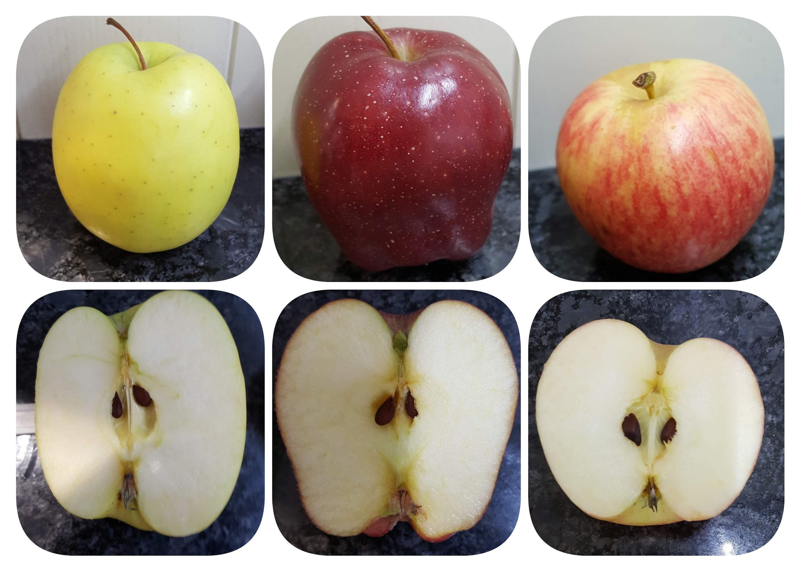
Different Outside, Same Core

Slide 3
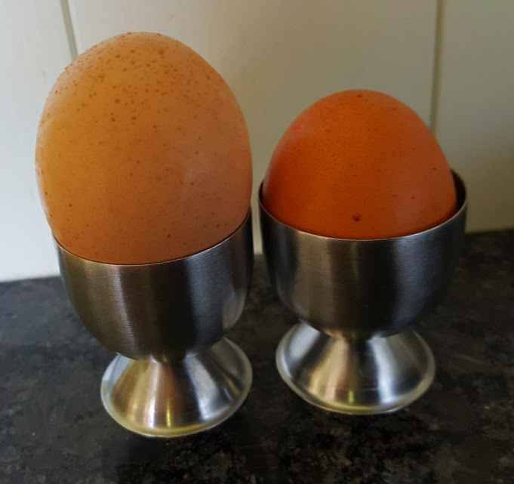
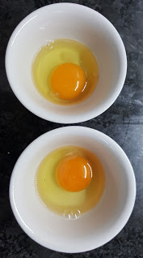
Different Eggs, Same Inside

Slide 4

Exploring Skin Colours

Slide 5
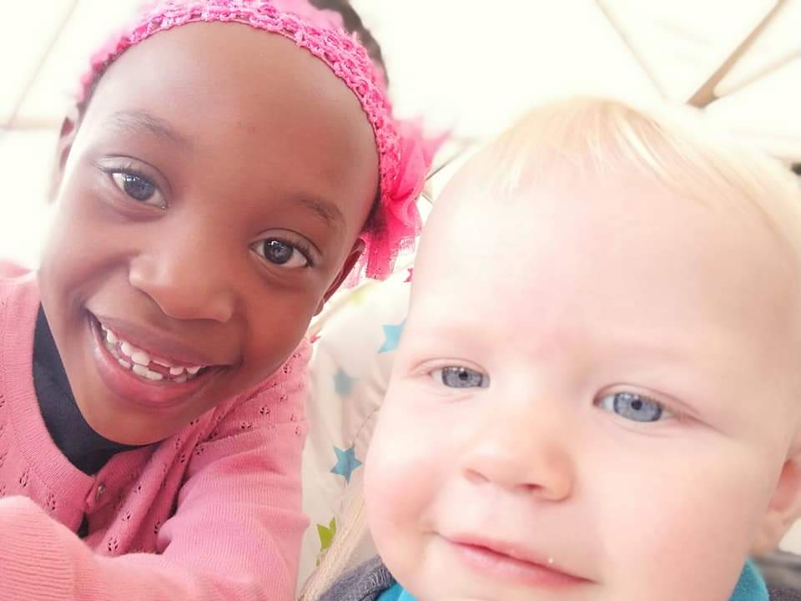
Brother and Sister

Slide 6
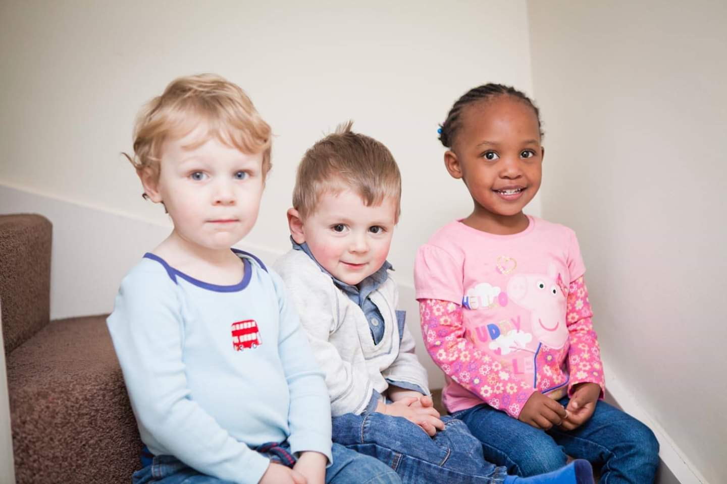
Cousins

Slide 7
What Am I Good At?
What Am I Interested In?

Slide 8
Diversity - Key Learning
We are all different and the same
We need people with different interests and skills
Everyone is unique
Be proud of who you are and what you are good at
We need people to do jobs they are good at
There is no one type of person who can do a certain job
People may not be what you first think, it is not just what you look like
Who you are comes from the inside
Everyone has something to celebrate about themself

Slide 9
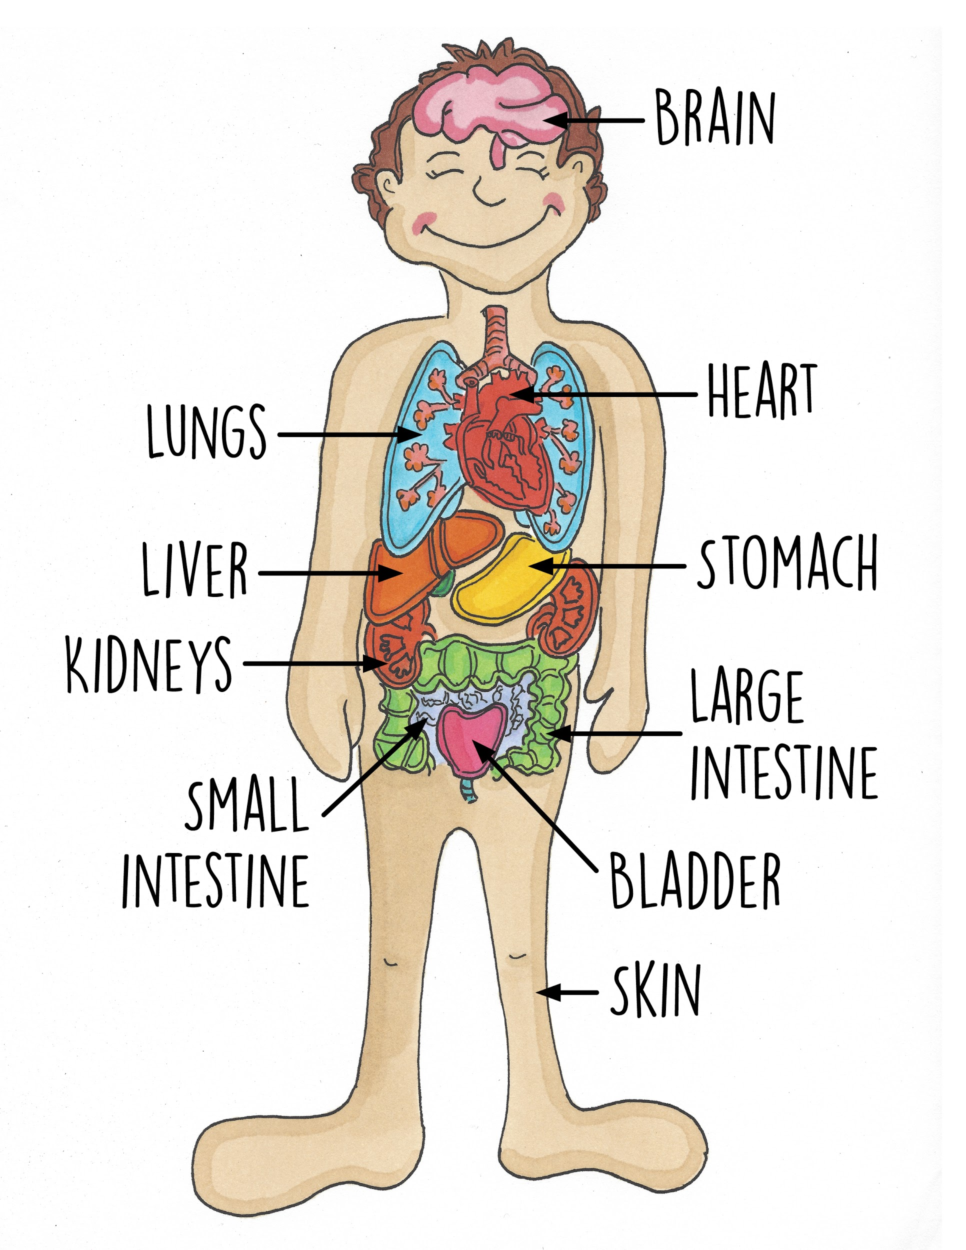
What We Look Like Inside (Main Organs)

Slide 10
Working in a Hospital
(Tune of Twinkle, Twinkle Little Star)
Working in a hospital
There are jobs for us all
Doctor, nurse, receptionist
Porter, cook, or scientist
Working in a hospital
There are jobs for us all

Slide 11
Working in a hospital
You might be short or tall
Black or white, large or thin
Who you are is within
Working in a hospital
There are jobs for us all

Slide 12
Working in a hospital
You might be a boy or girl
You can do anything
From clinical to admin
Working in a hospital
There are jobs for us all

Slide 13
Working in a hospital
What you do it's your call
Midwife, accountant, dietitian
Human Resources or optician
Working in a hospital
There are jobs for us all

Slide 14


