Slide 1

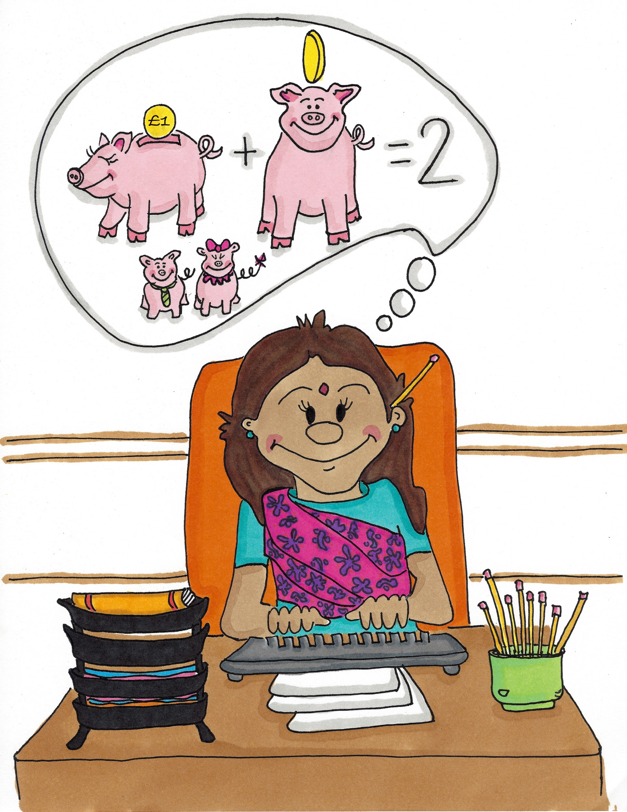
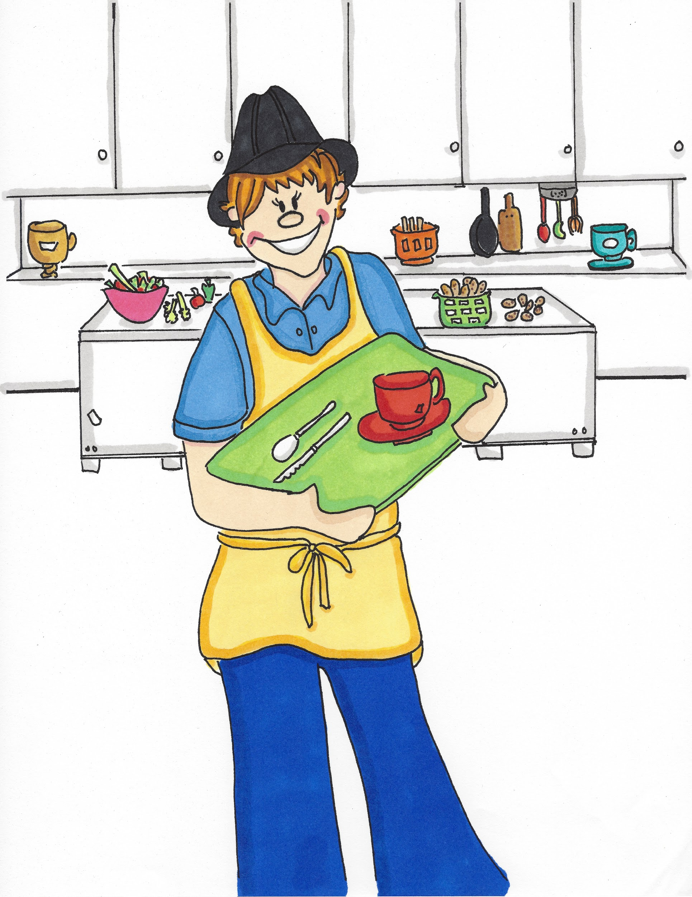
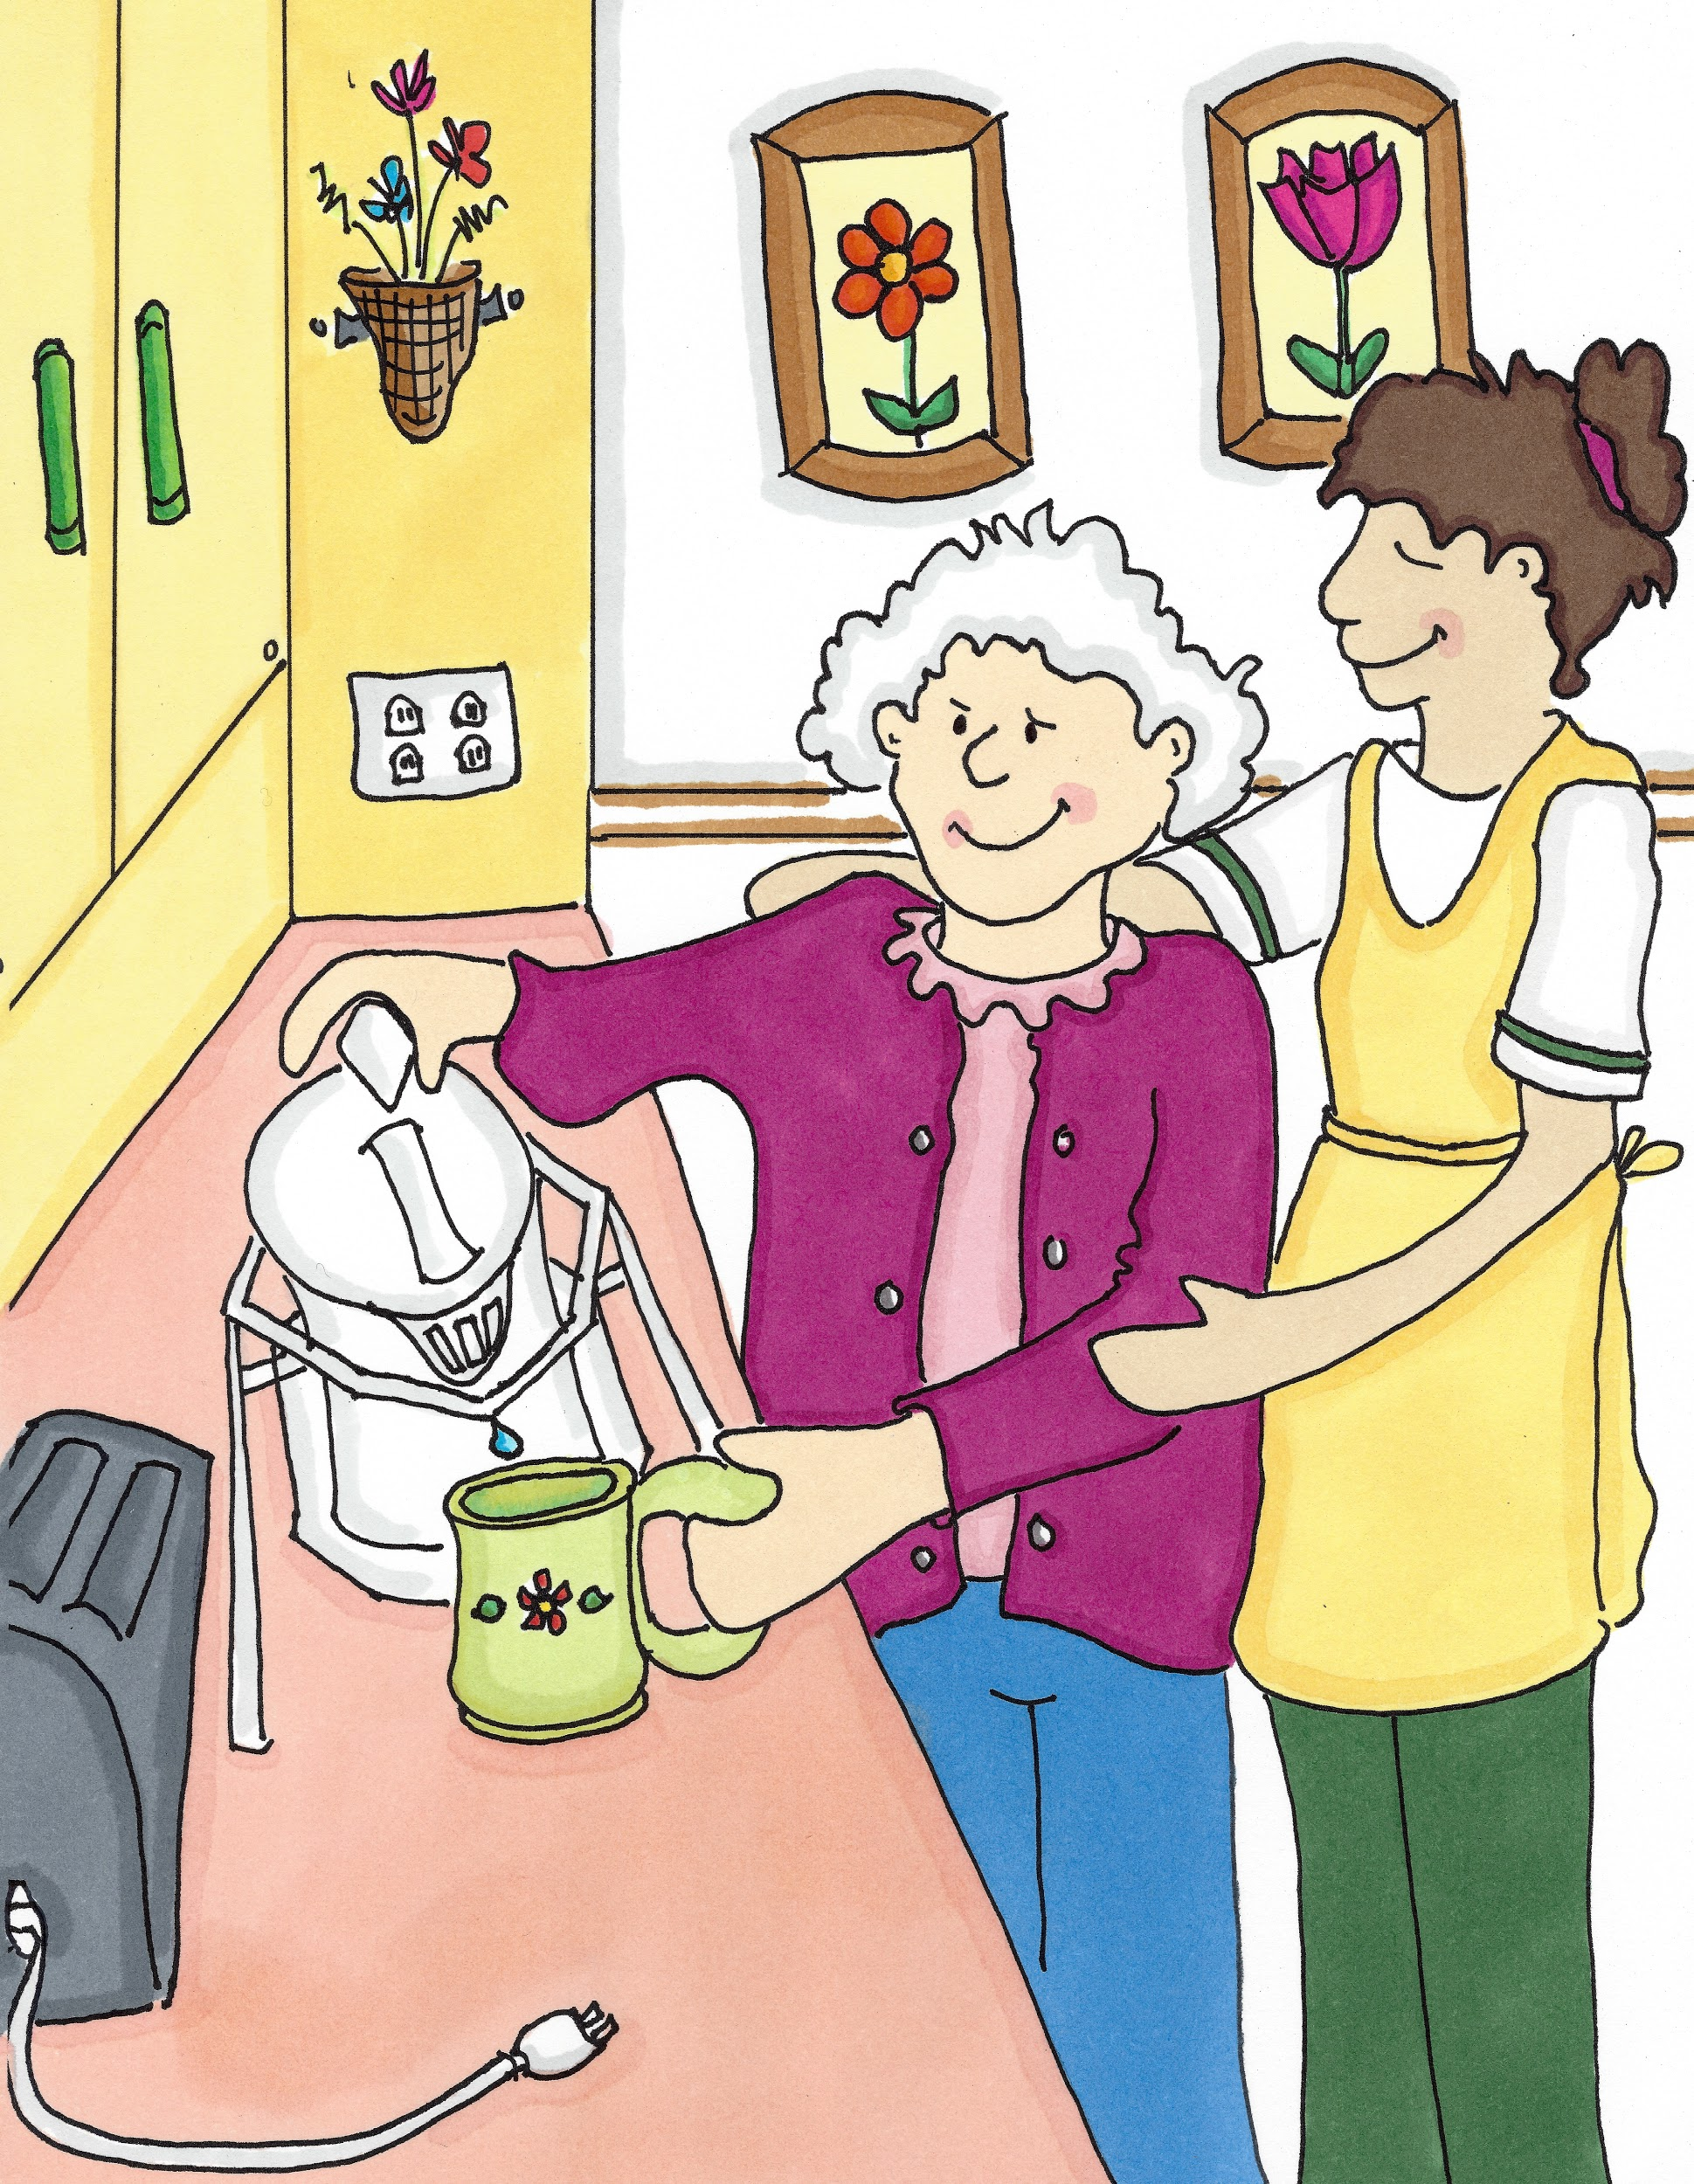
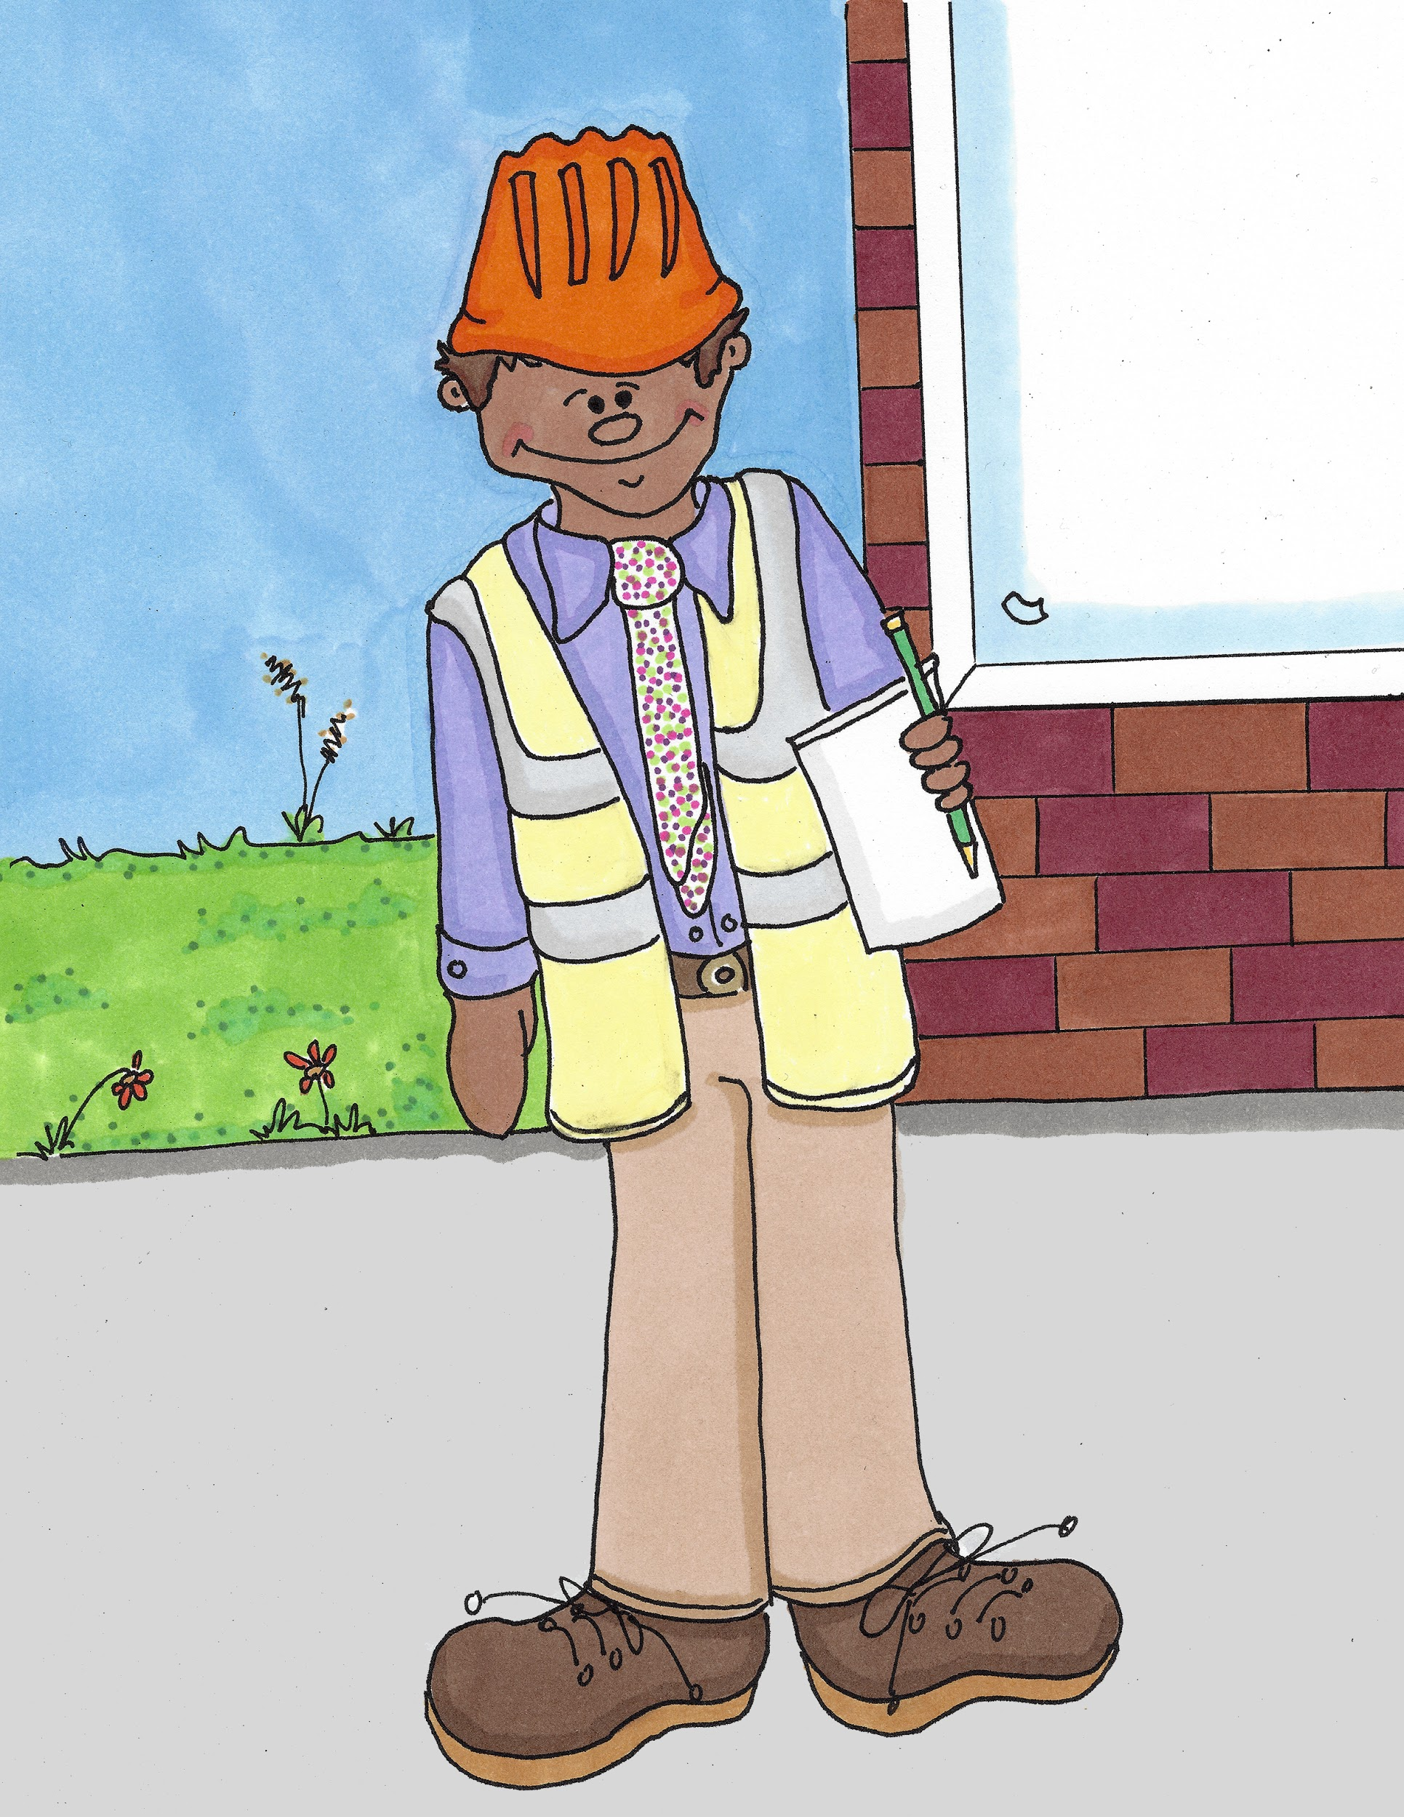
I Am Not a Doctor or a Nurse…
Part 2

Slide 2
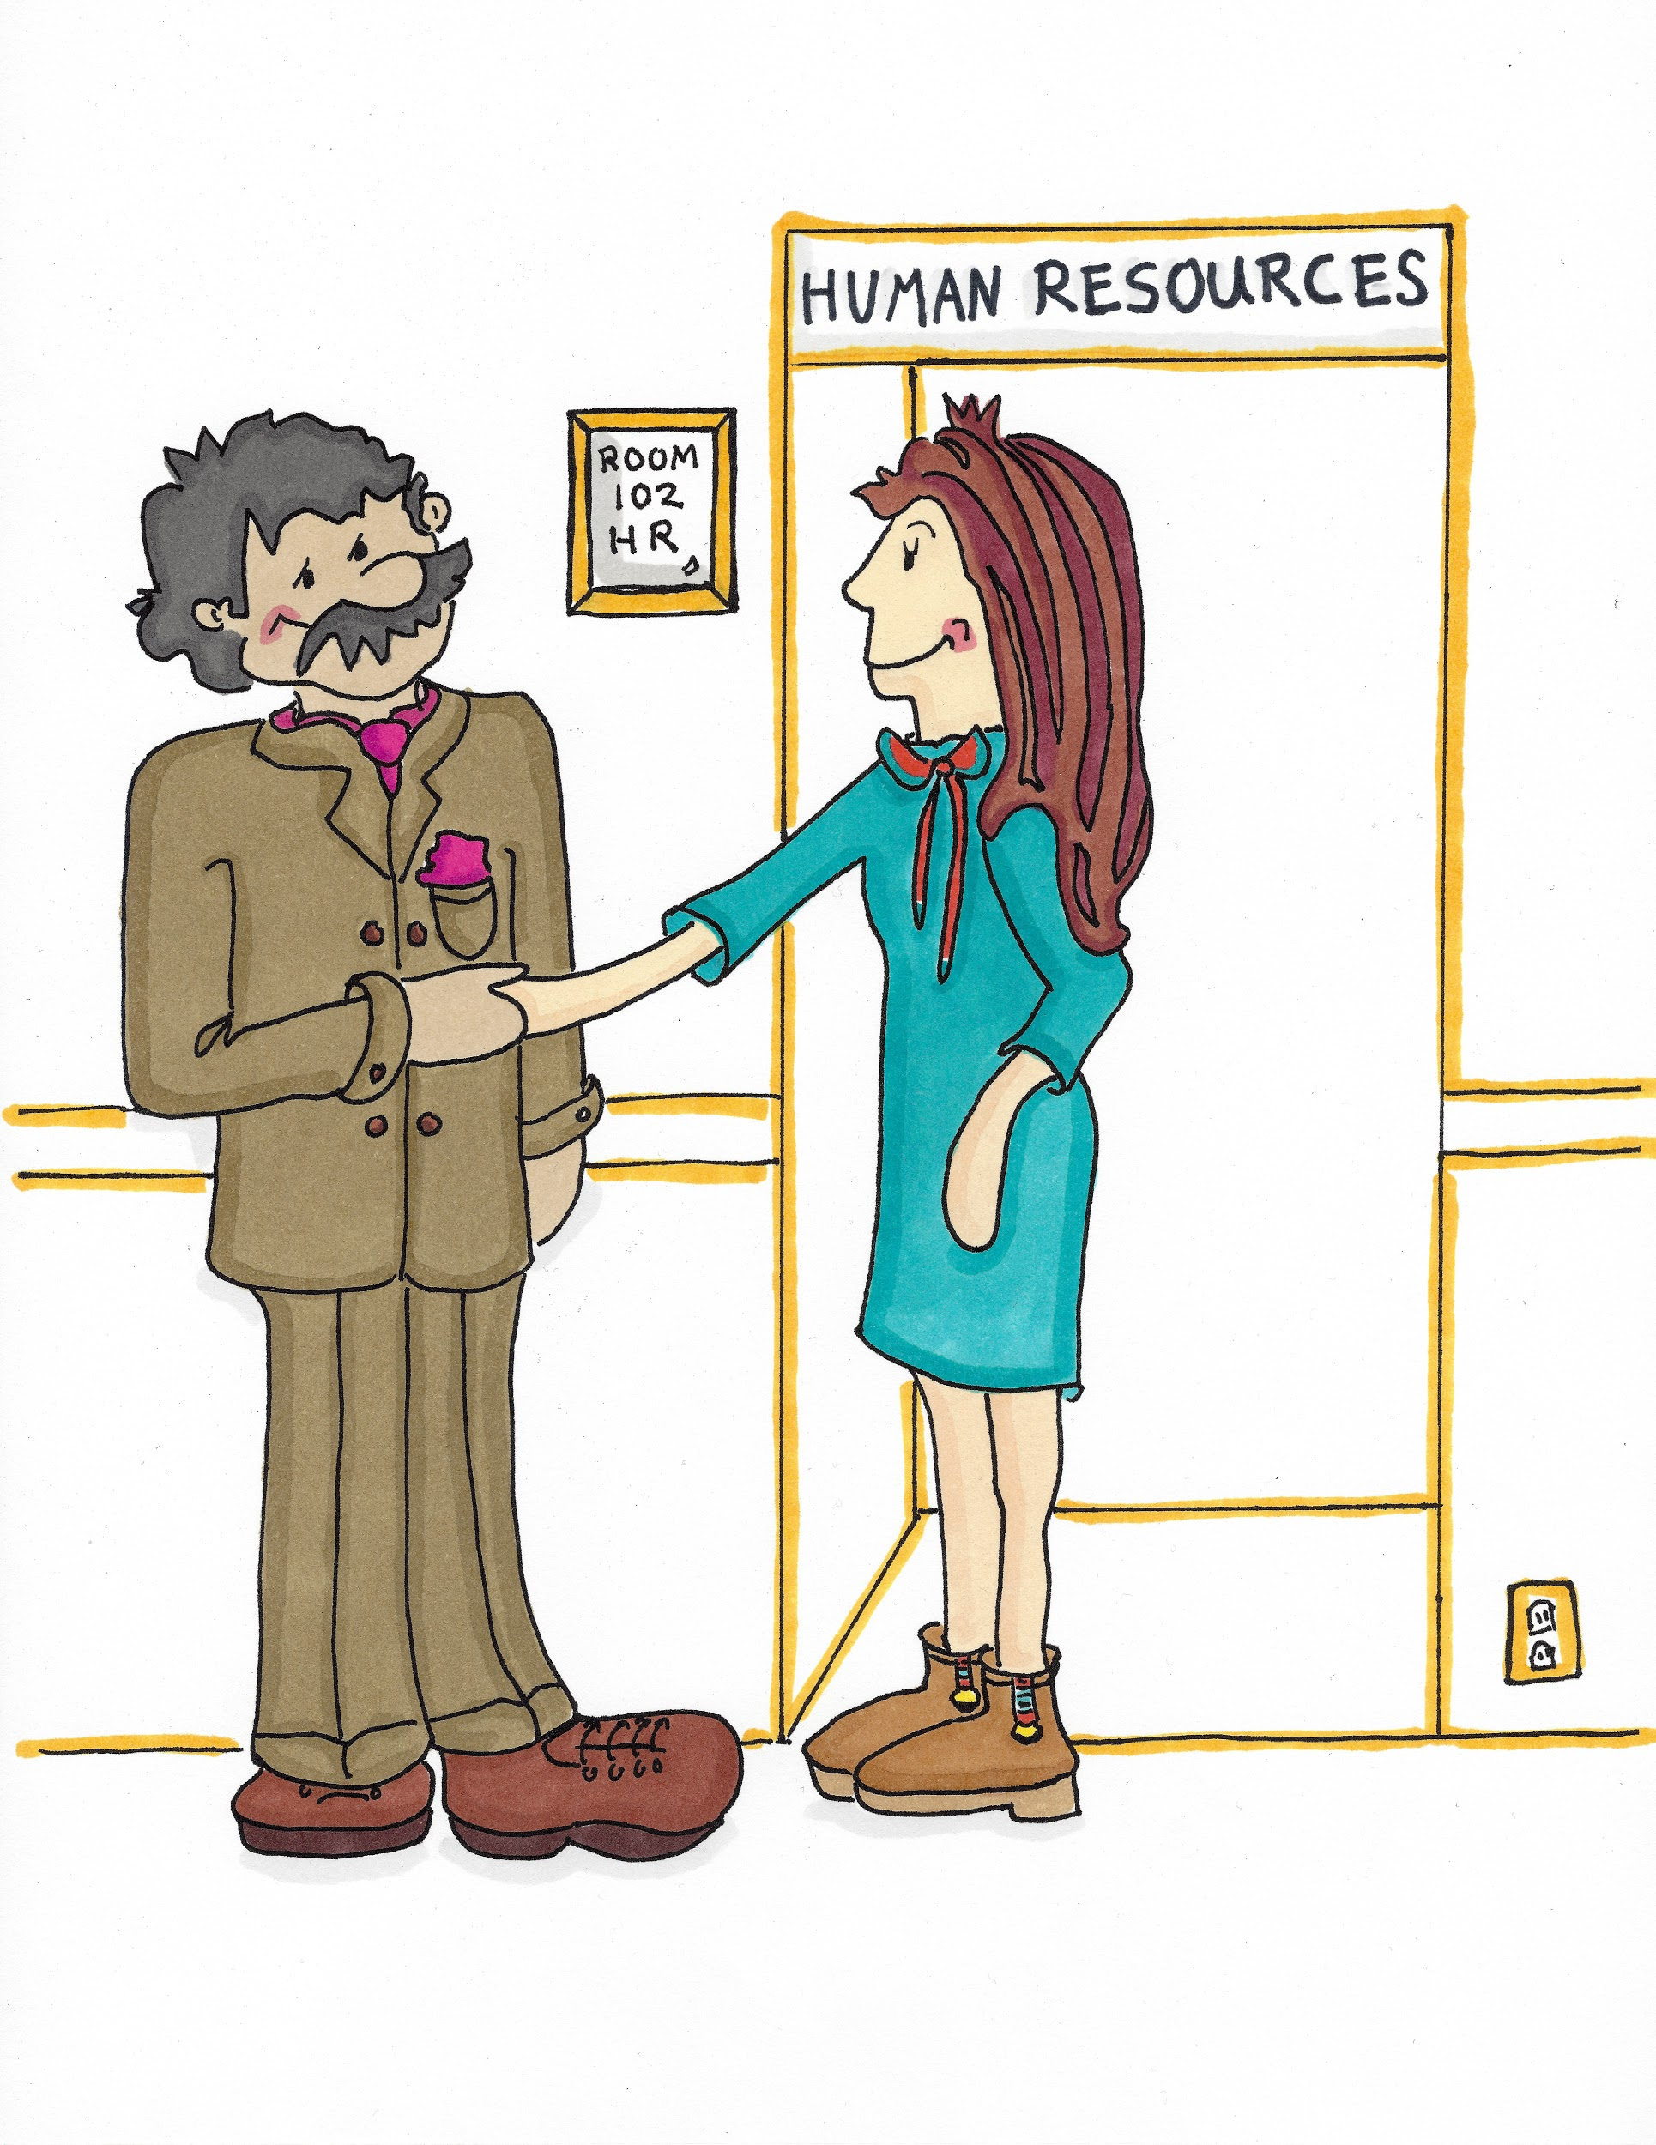
I am not a Doctor or a Nurse...
I work in Human Resources (H/yoo/man Re/sor/ses). I deal with anything to do with the people who work here.

Slide 3
I am not a Doctor or a Nurse...
I am an Accountant (A/kouwn/tant). I look after the money.

Slide 4
I am not a Doctor or a Nurse...
I am a Catering Assistant (Cay/tir/ing A/sis/tant). I get meals ready for patients and make sure they are not worried about what they can have to eat in hospital or a care home.

Slide 5
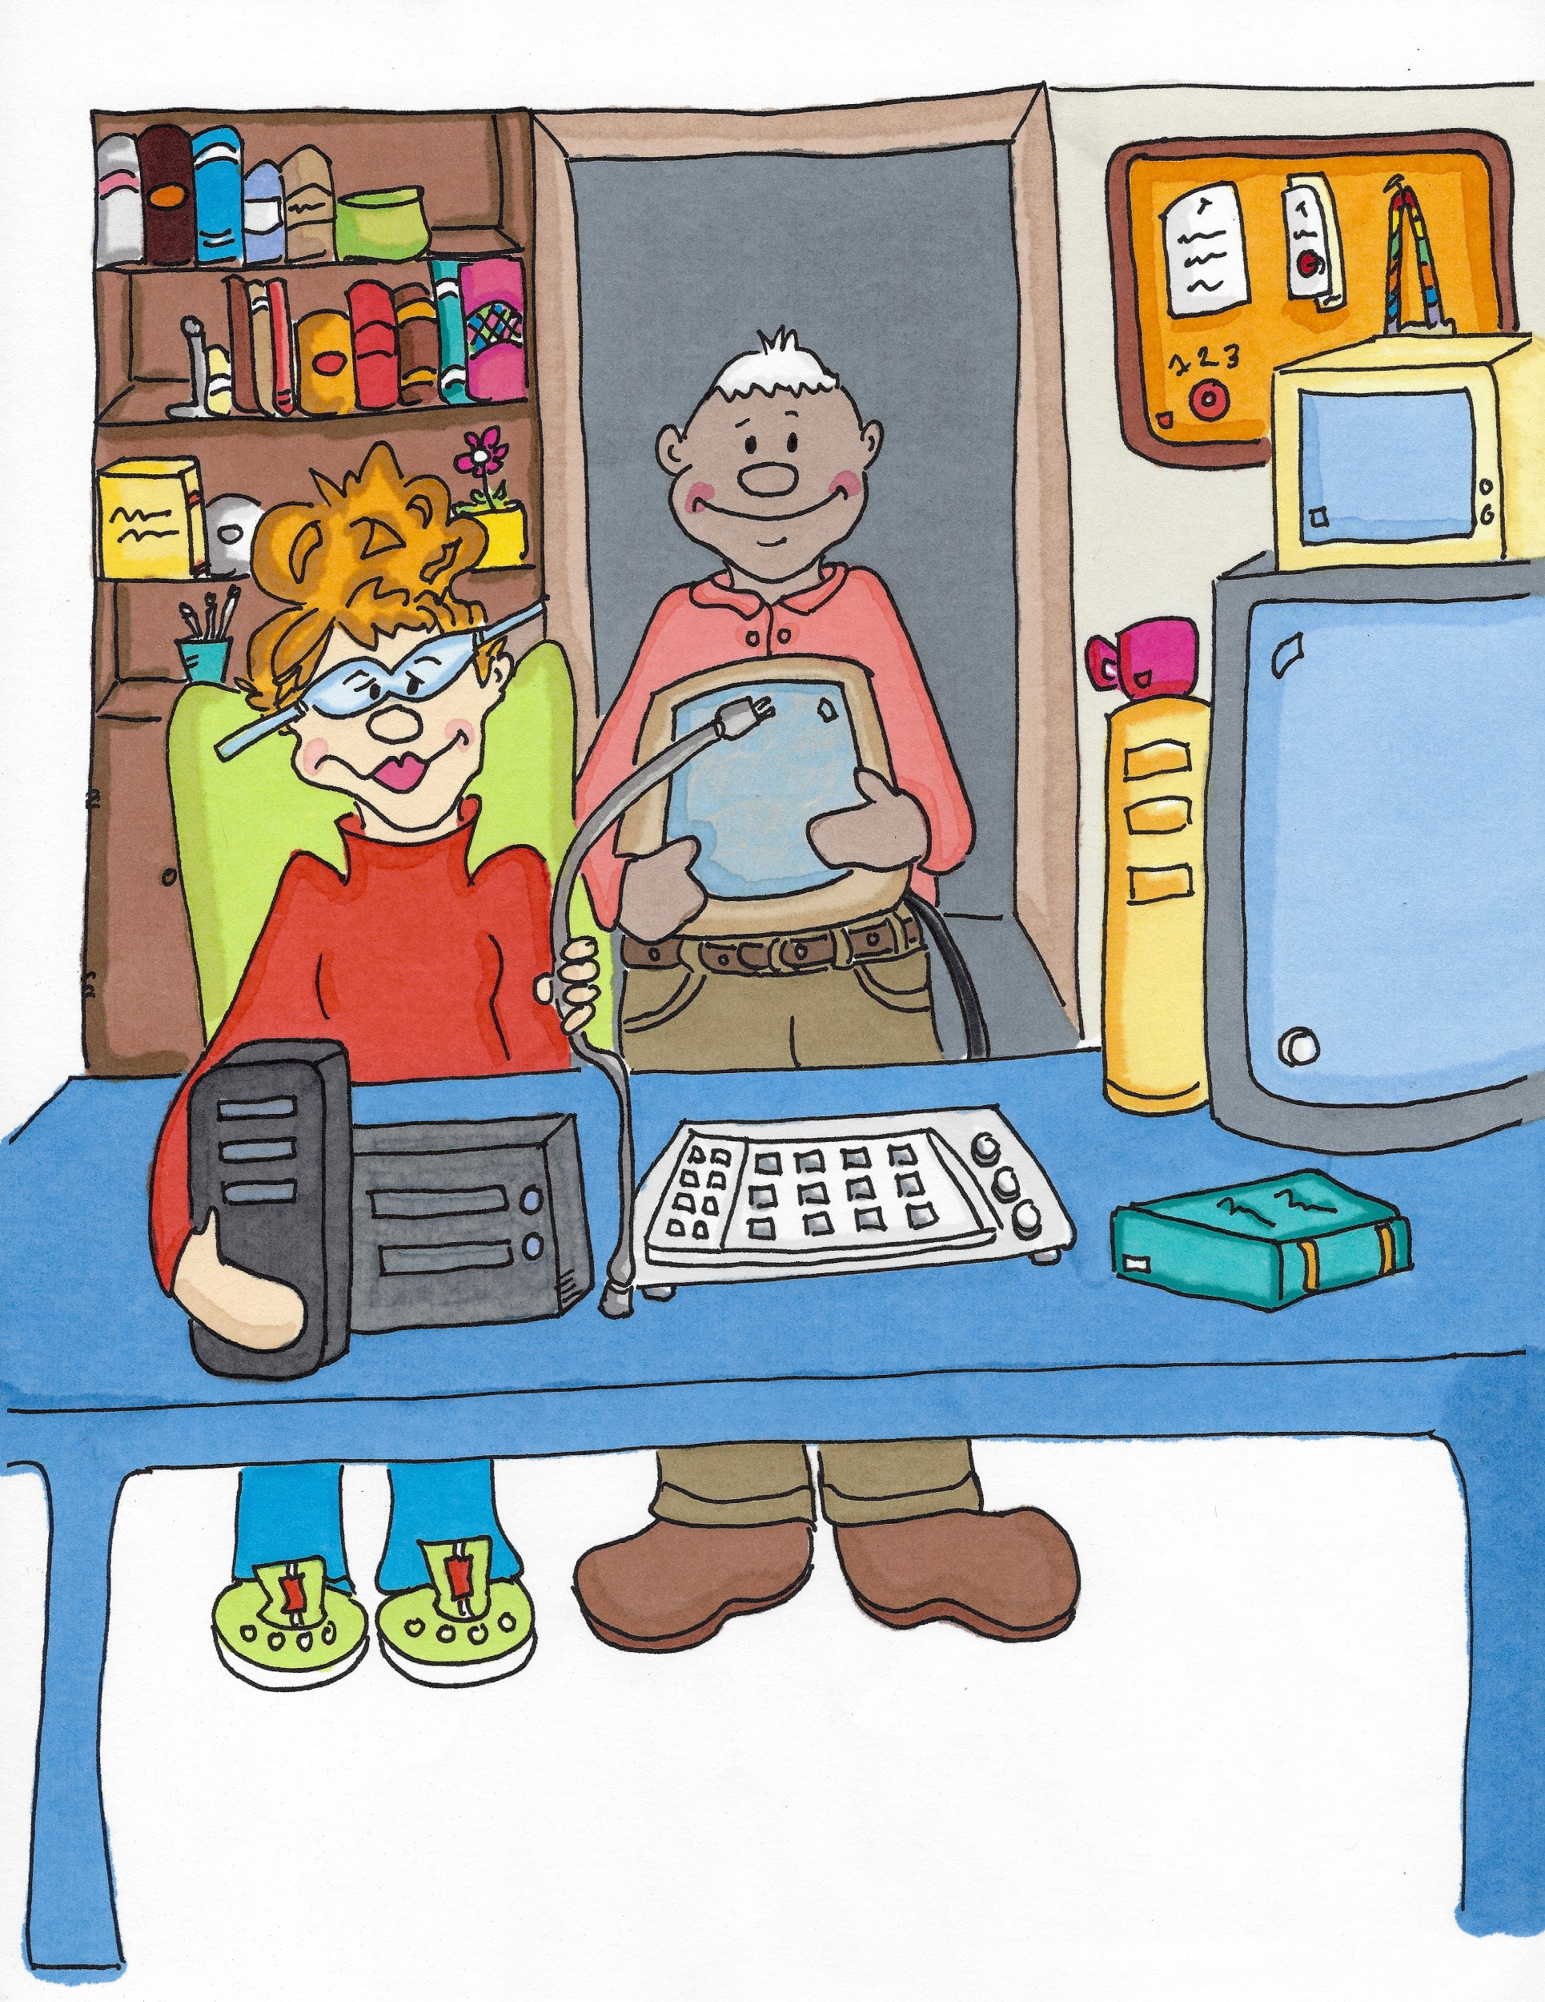
I am not a Doctor or a Nurse...
I am an IT Technician (Igh/Tee Tec/ni/shun). I look after the computers.

Slide 6
I am not a Doctor or a Nurse...
I am an Estates Engineer (E/stay/ts En/jin/eer). I look after the buildings.

Slide 7
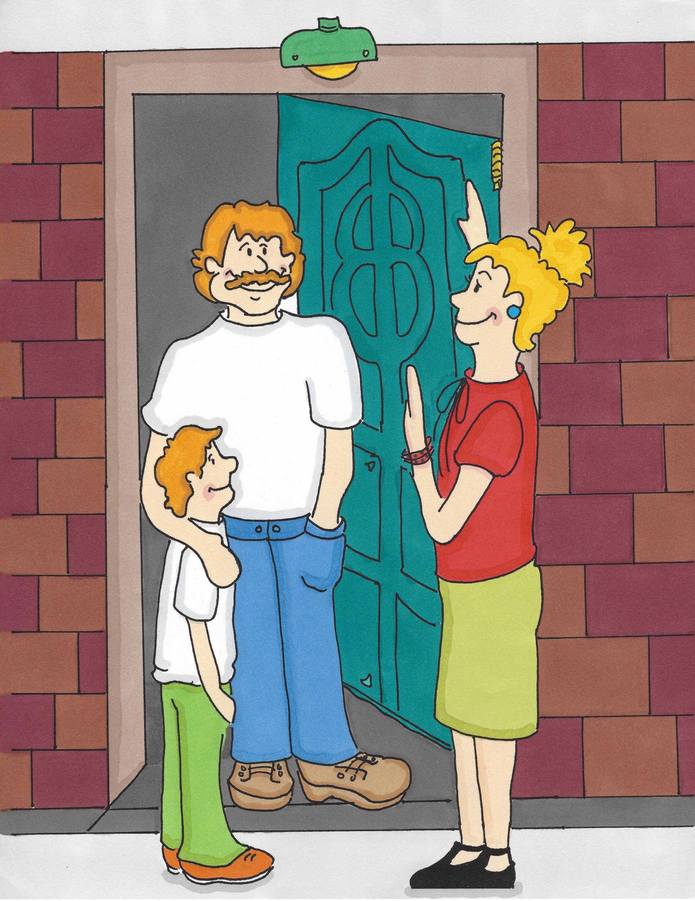
I am not a Doctor or a Nurse...
I am a Social Worker (Soa/shul Wir/kir). I protect children and adults from harm and help improve independence and wellbeing.

Slide 8
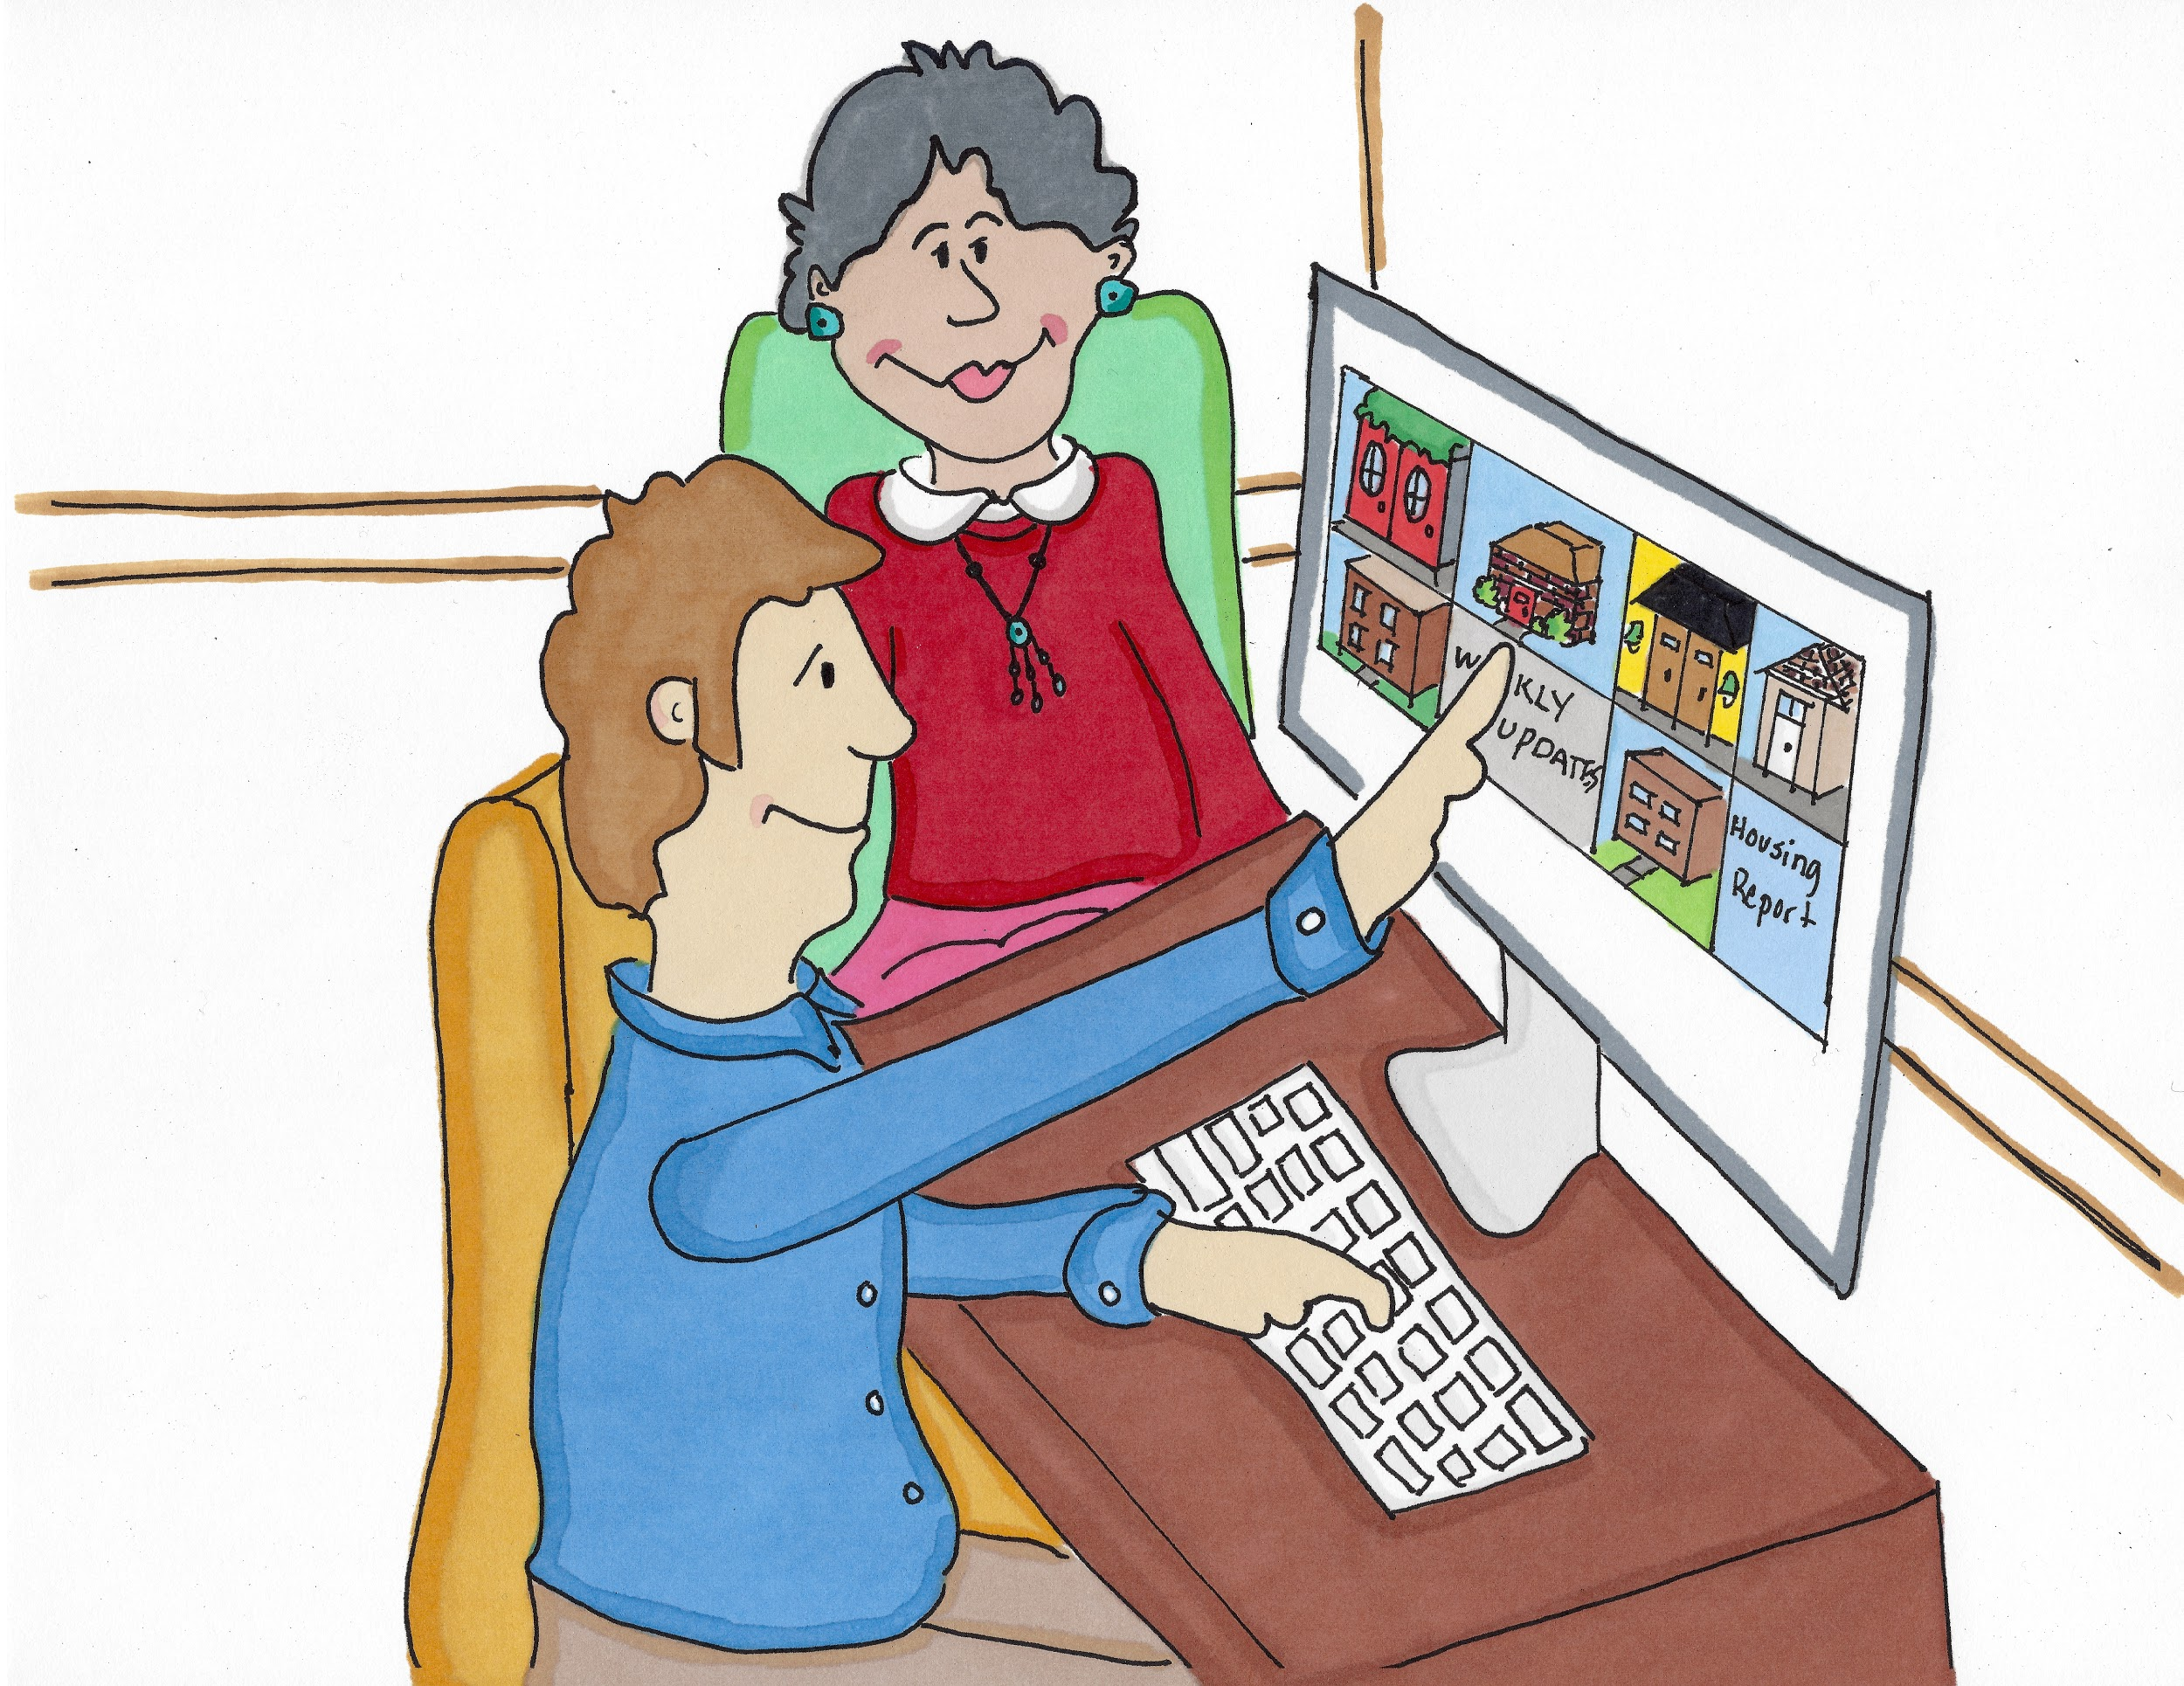
I am not a Doctor or a Nurse...
I am a Housing Support Officer (How/sing Su/port O/fi/sir). I help people to find and keep somewhere to live and be safe and secure.

Slide 9
I am not a Doctor or a Nurse...
I am an Occupational Therapist (Oc/yoo/pay/shun/al The/ra/pist). I help people to do day-to-day tasks better if they are disabled, injured or poorly. With my help and lots of practice they will be able to do more for themselves and need less help from their family or Care Workers.

Slide 10
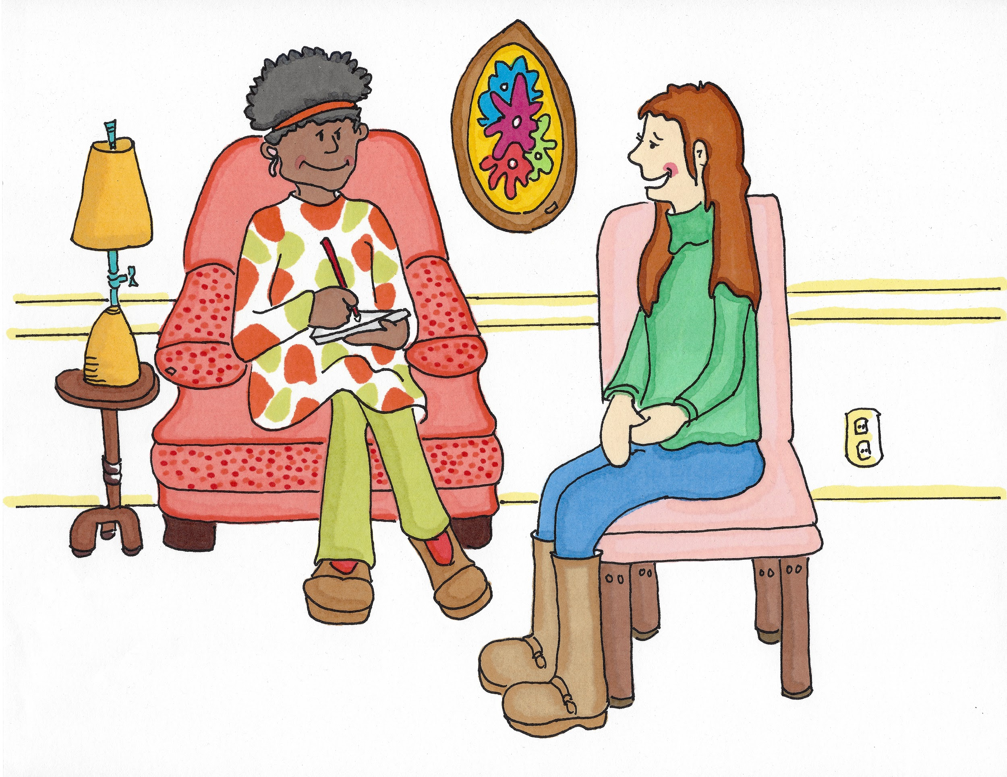
I am not a Doctor or a Nurse...
I am a Counsellor (Cown/sel/or). I help people to solve problems, talk about their feelings and to have a happy and healthy mind.

Slide 11
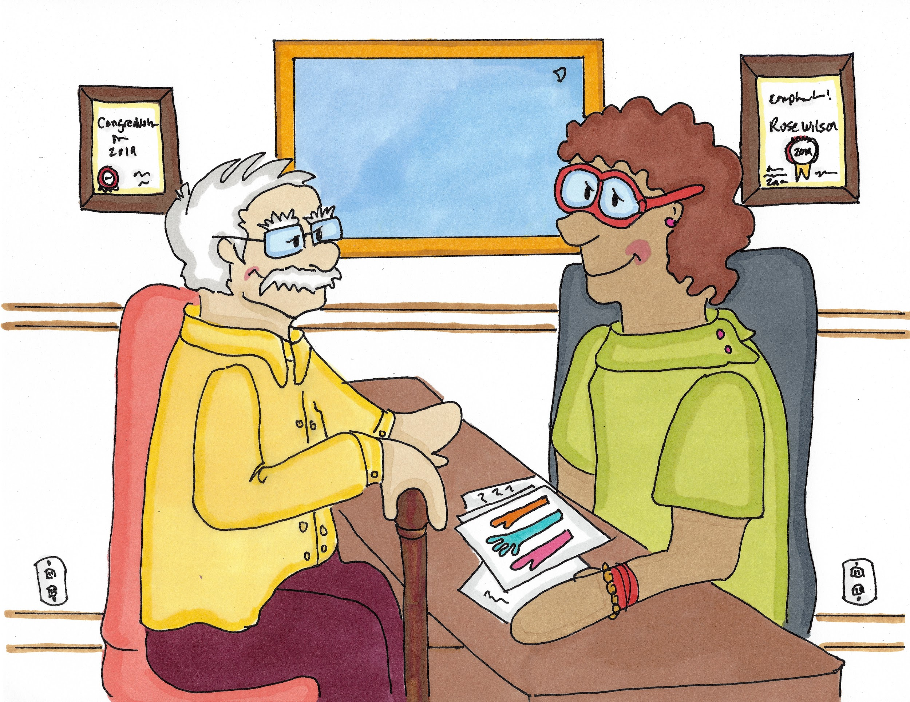
I am not a Doctor or a Nurse...
I am a Social Prescriber (Soa/shul Pre/scrigh/bir). I help people not to be lonely. I help them with things like making friends, finding a job, joining a group or learning new skills. This helps people to be healthy and happy.

