Slide 1

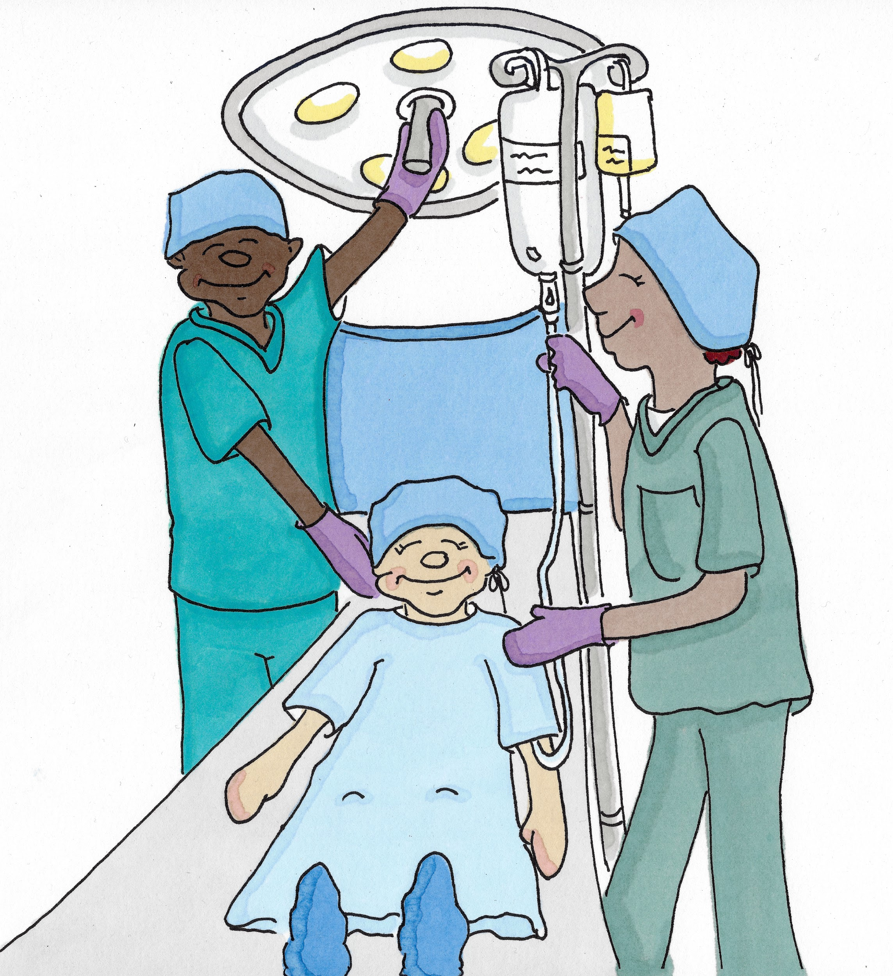

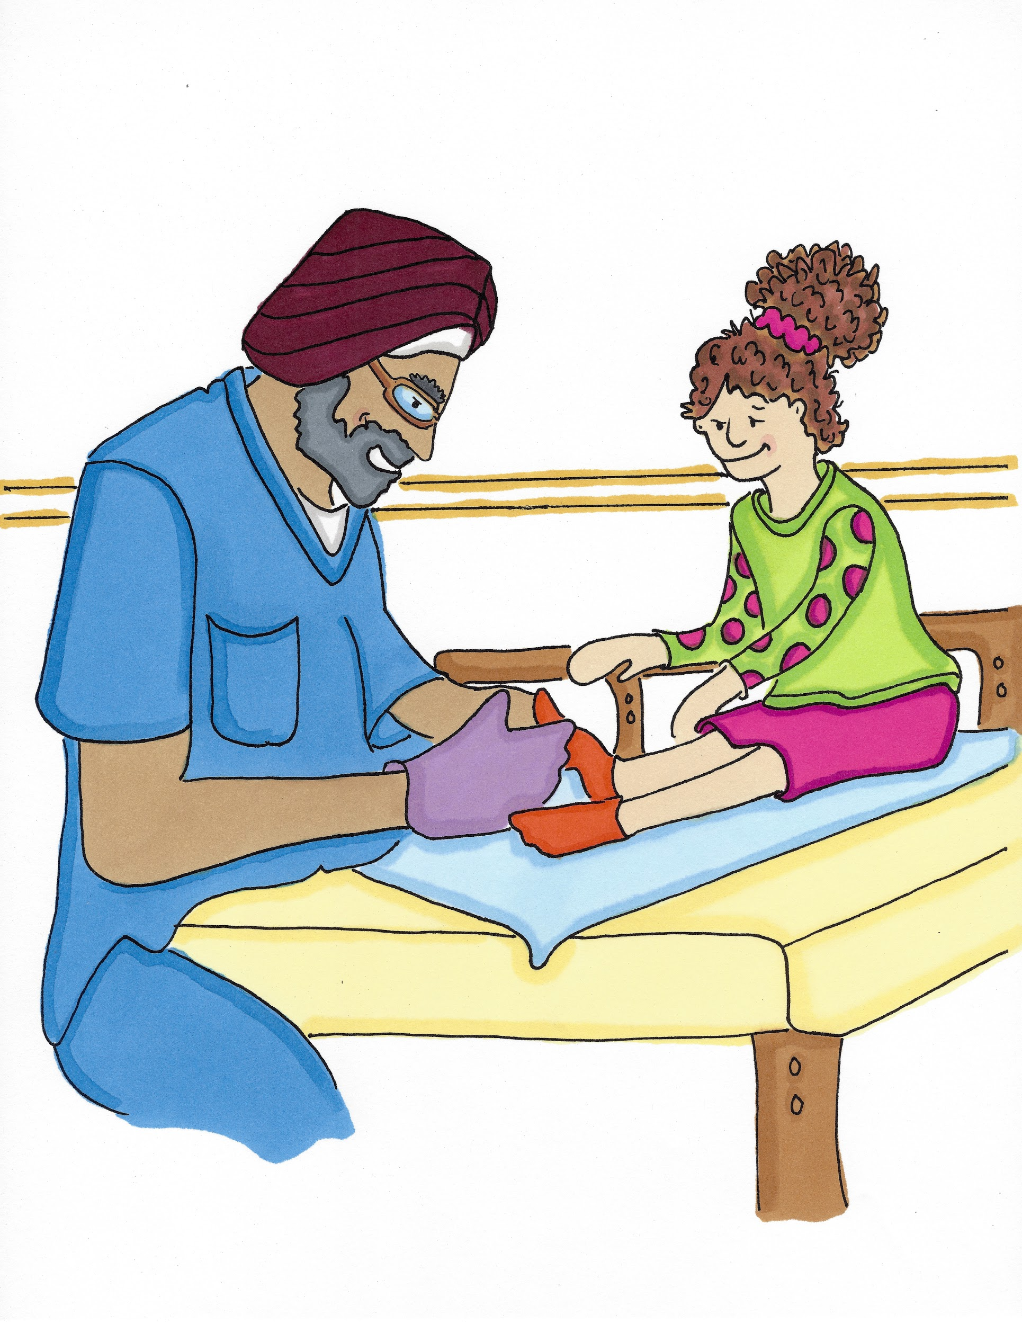
I Am Not a Doctor or a Nurse…
Part 1

Slide 2
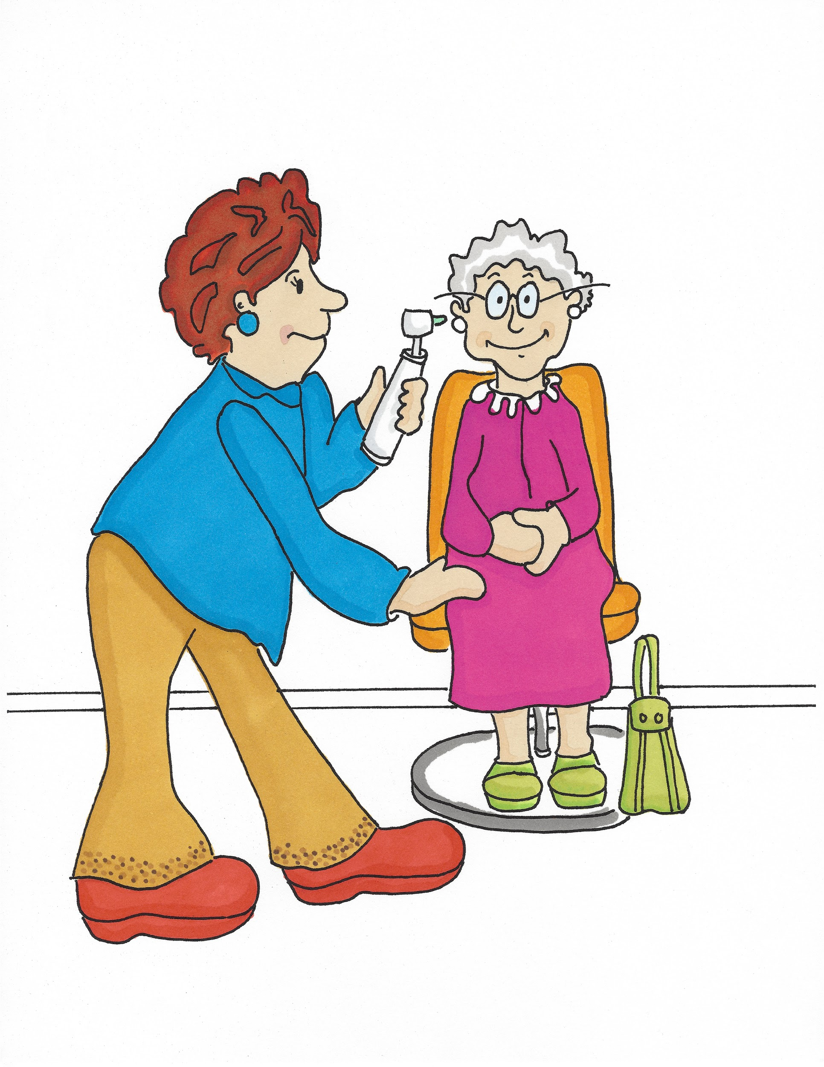
I am not a Doctor or a Nurse...
I am an Audiologist (Or/dee/ol/o/jist). I check ears. If there is something wrong in your ear you may not be able to hear properly, you may get ear ache and sometimes you feel dizzy.

Slide 3
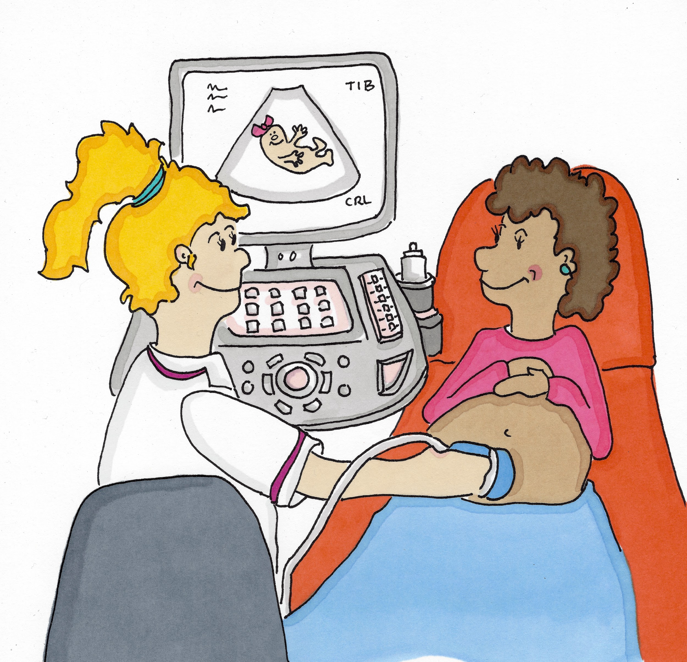
I am not a Doctor or a Nurse...
I am a Sonographer (Son/o/gra/fir). I use ultrasound to see if someone is poorly or hurt inside their body. I can even look at babies growing inside their mummies’ tummies to see if they are healthy.

Slide 4
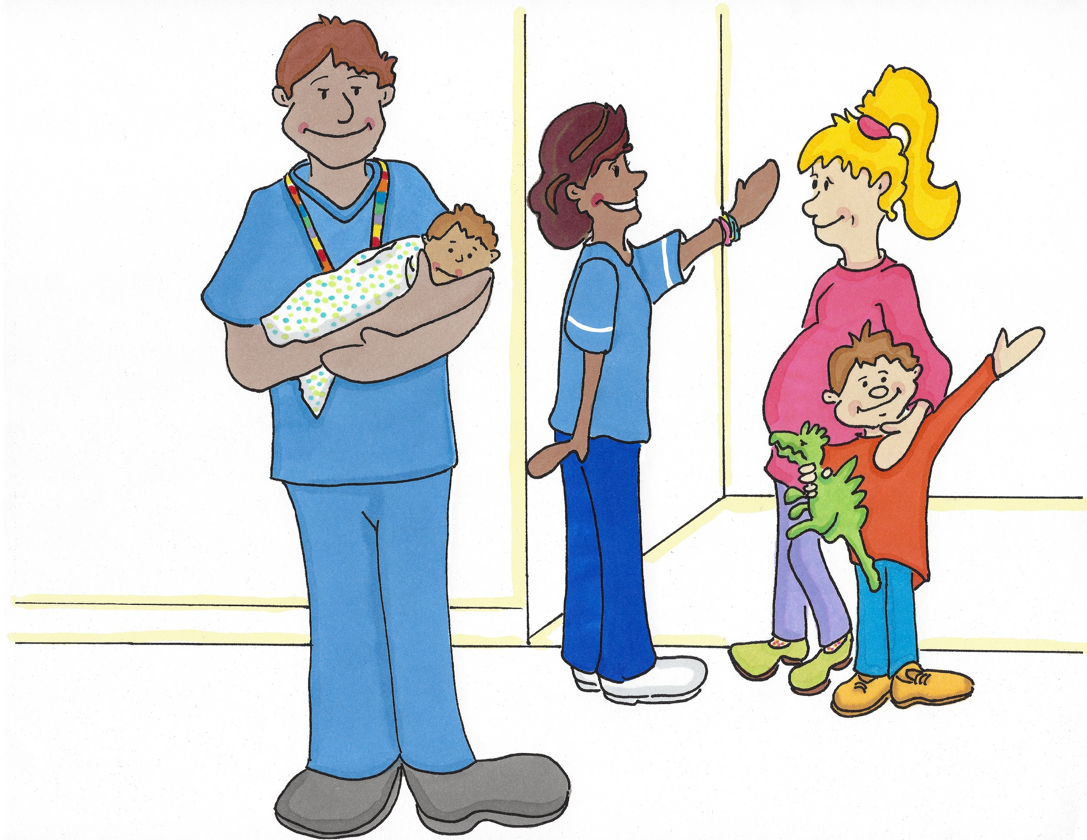
I am not a Doctor or a Nurse...
I am a Midwife (Mid/wigh/f). I look after mummies and their babies before, during and after the baby is born.

Slide 5
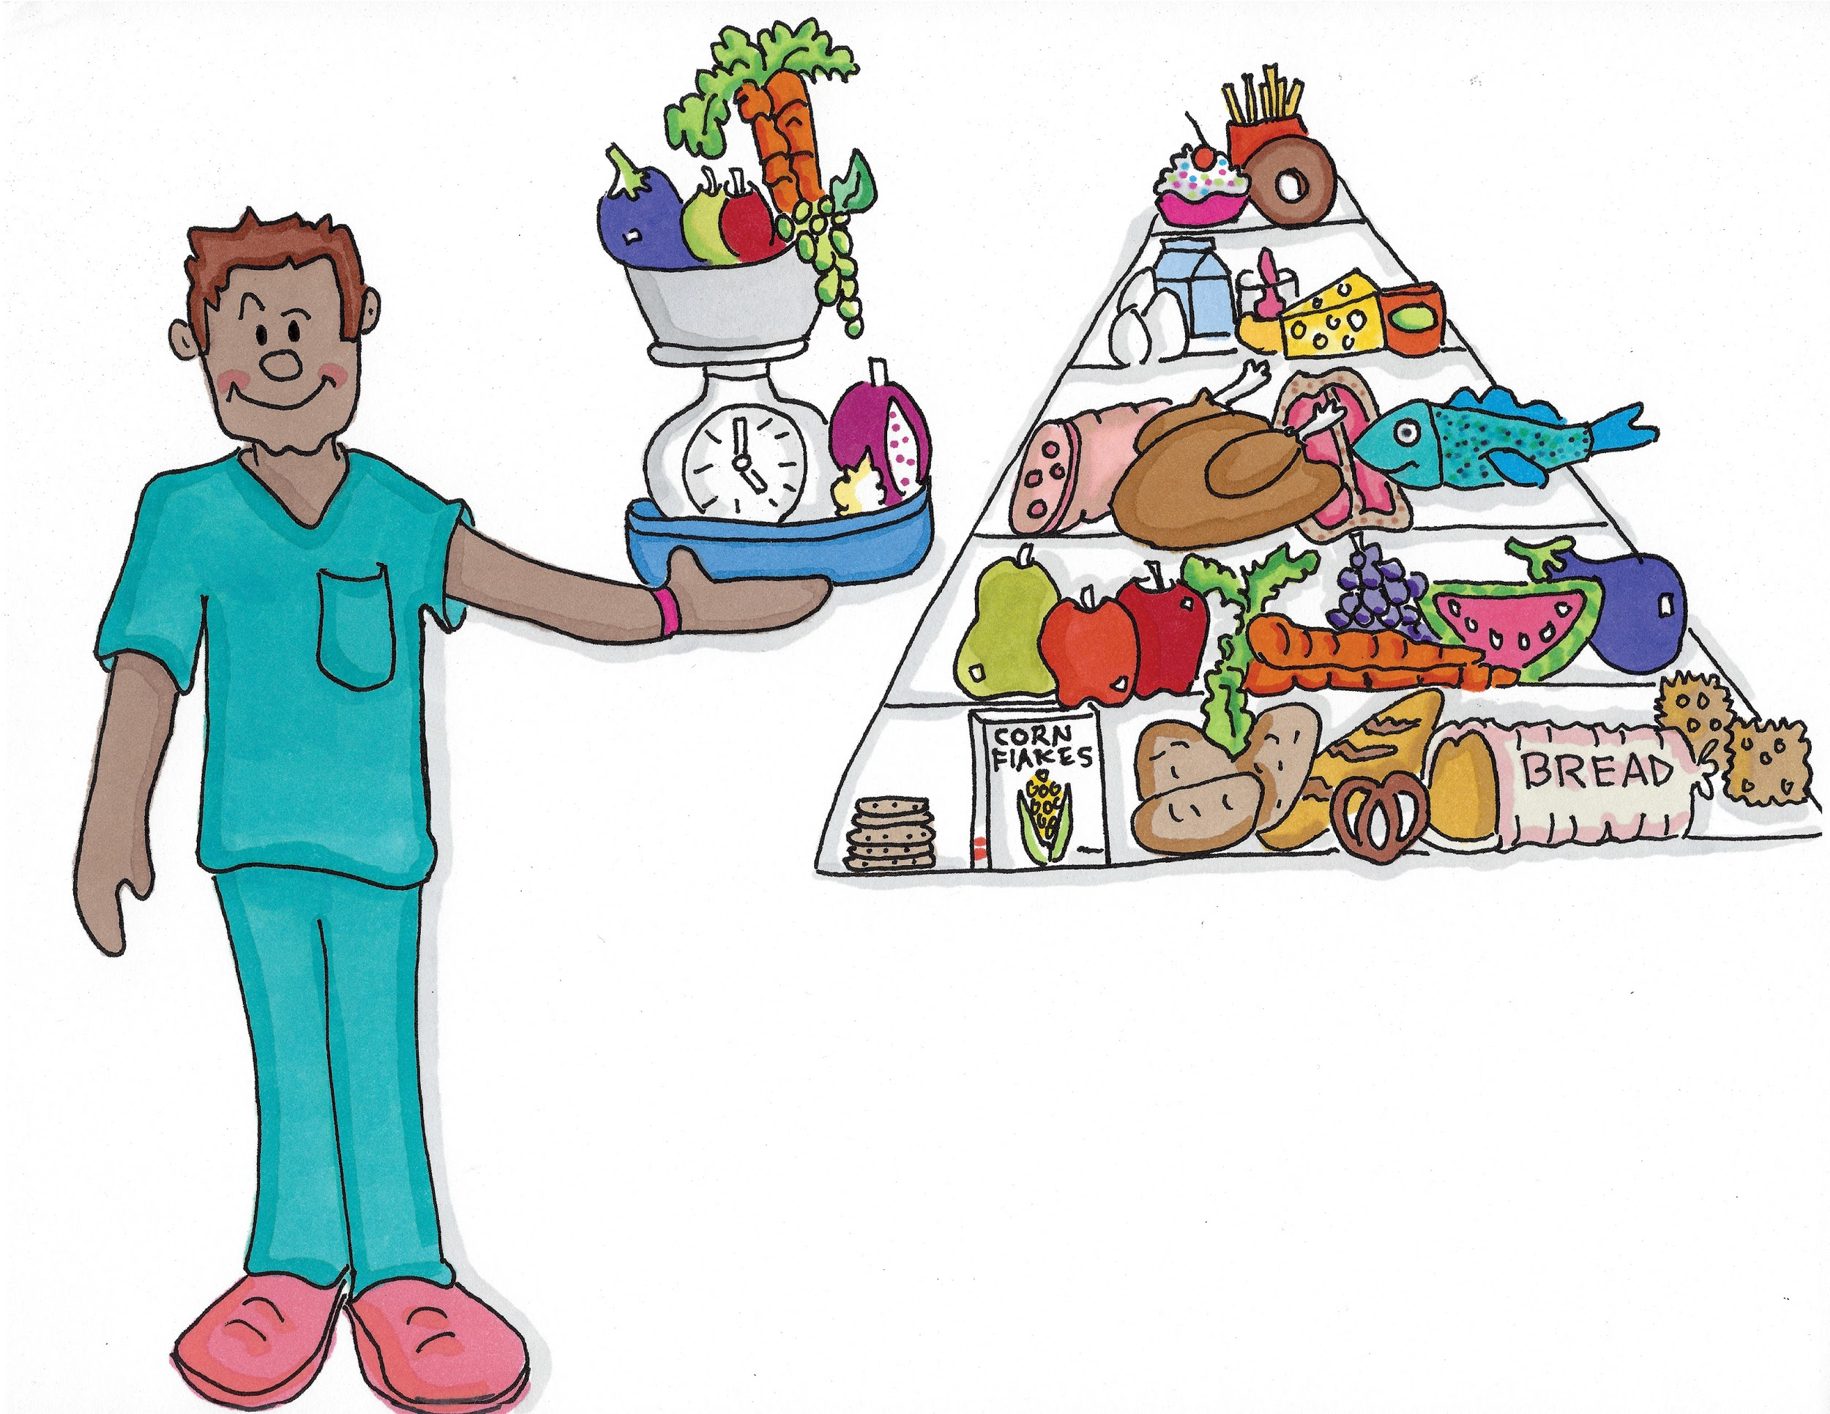
I am not a Doctor or a Nurse...
I am a Dietitian (Digh/e/ti/shun). I make sure patients get what they need from food even if they are not able to eat normally.

Slide 6
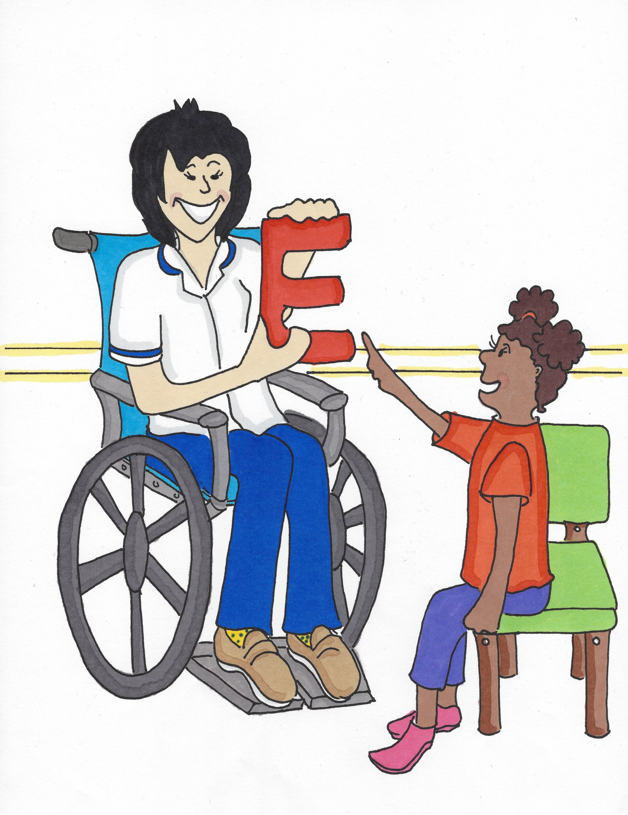
I am not a Doctor or a Nurse...
I am a Speech and Language Therapist (Spee/ch and Lan/gwij The/ra/pist). I help people when they are struggling to talk or have problems swallowing.

Slide 7
I am not a Doctor or a Nurse...
I am a Podiatrist (Pod/igh/e/trist). I look after people’s feet.

Slide 8
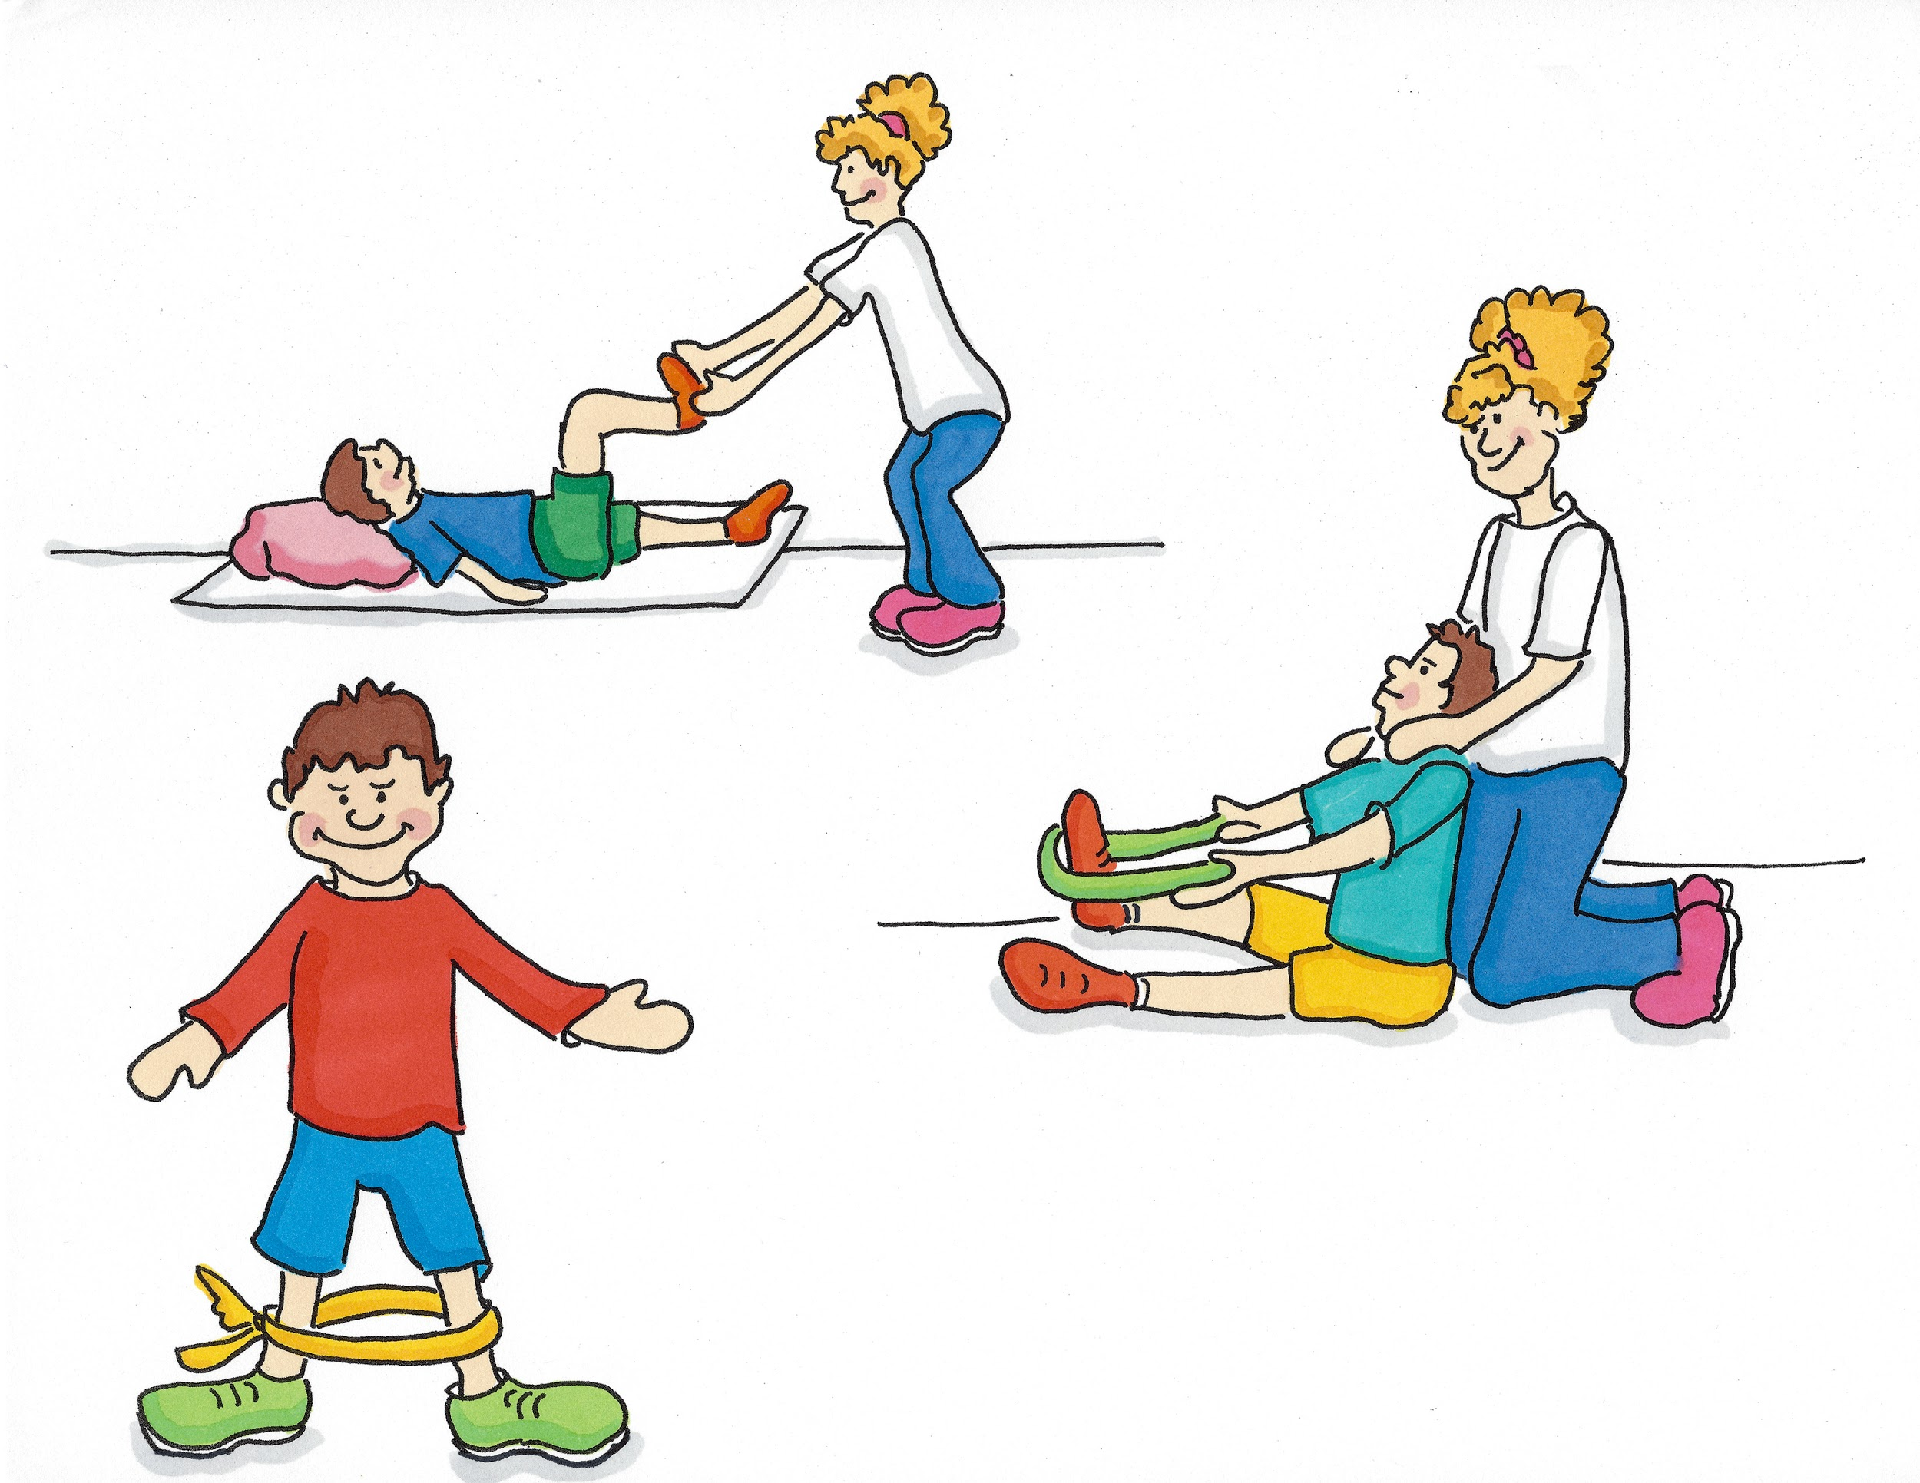
I am not a Doctor or a Nurse...
I am a Physiotherapist (Fi/si/oa/the/ra/pist). I help people to move better.

Slide 9
I am not a Doctor or a Nurse...
I am an Operating Department Practitioner or ODP (Op/ir/ay/ting Dee/part/ment Prac/ti/shun/ir). I work in theatres helping to look after patients when they have an operation.

Slide 10
I am not a Doctor or a Nurse...
I am a Pharmacist (Far/ma/sist). I am in charge of all the medicines patients need.

Slide 11
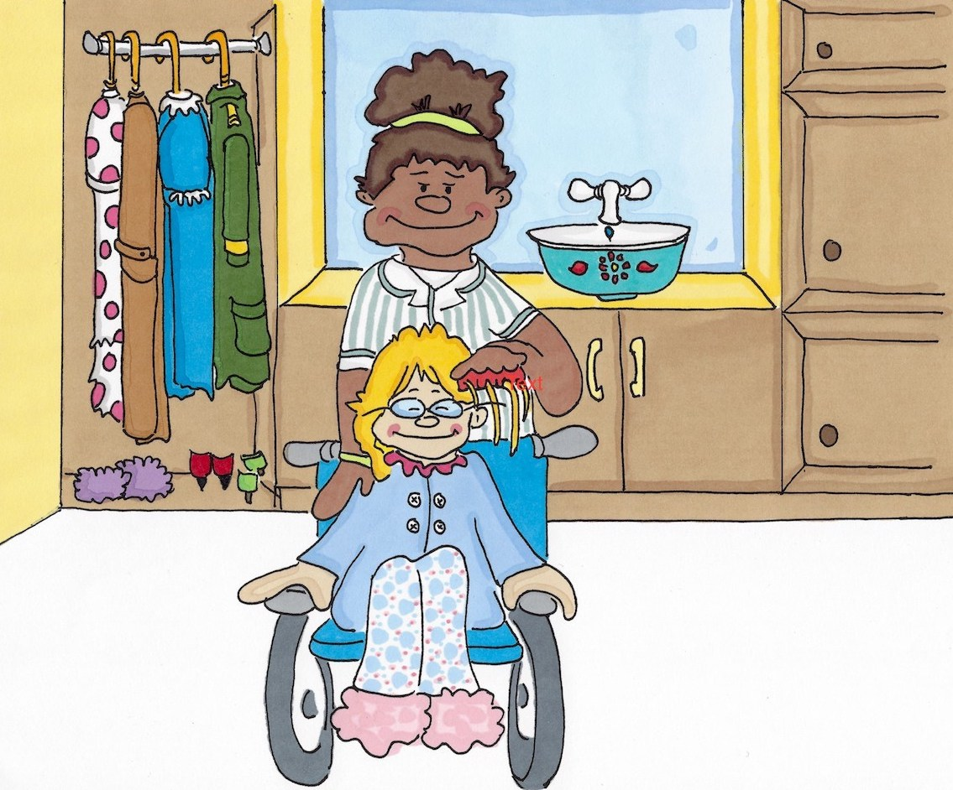
I am not a Doctor or a Nurse...
I am a Care Worker (Cair Wirk/ir). I help with day-to-day living including washing, dressing and mealtimes.

Slide 12


