Slide 1

Where Could I Work?

Slide 2
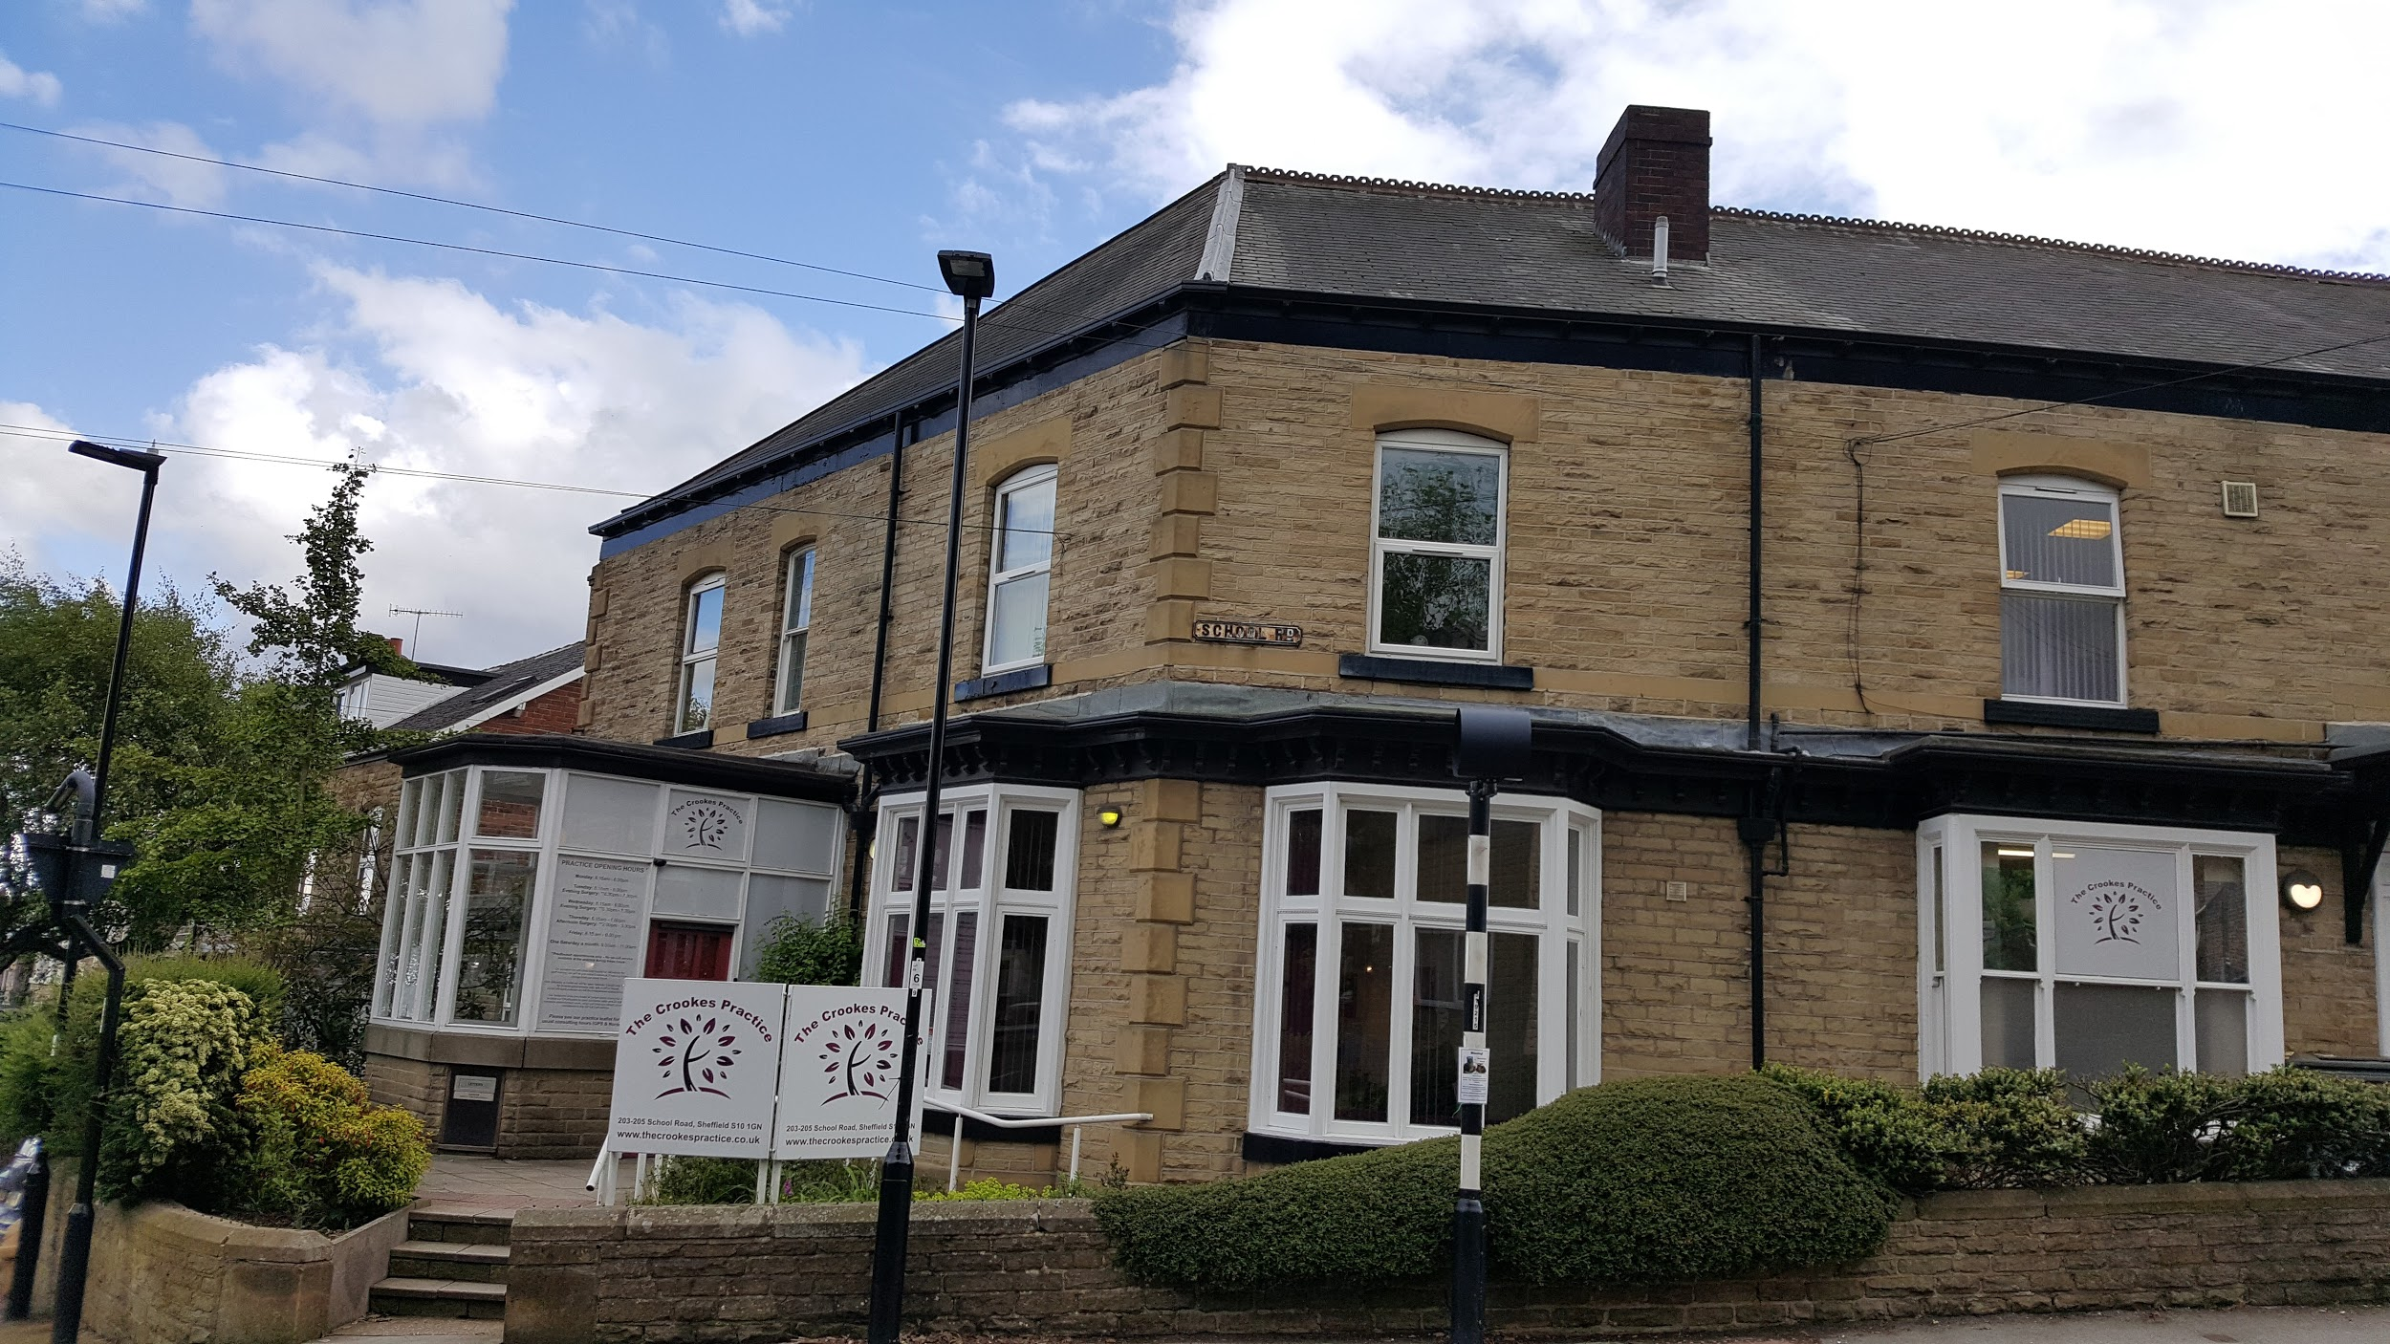
Doctors’ Surgery

Slide 3
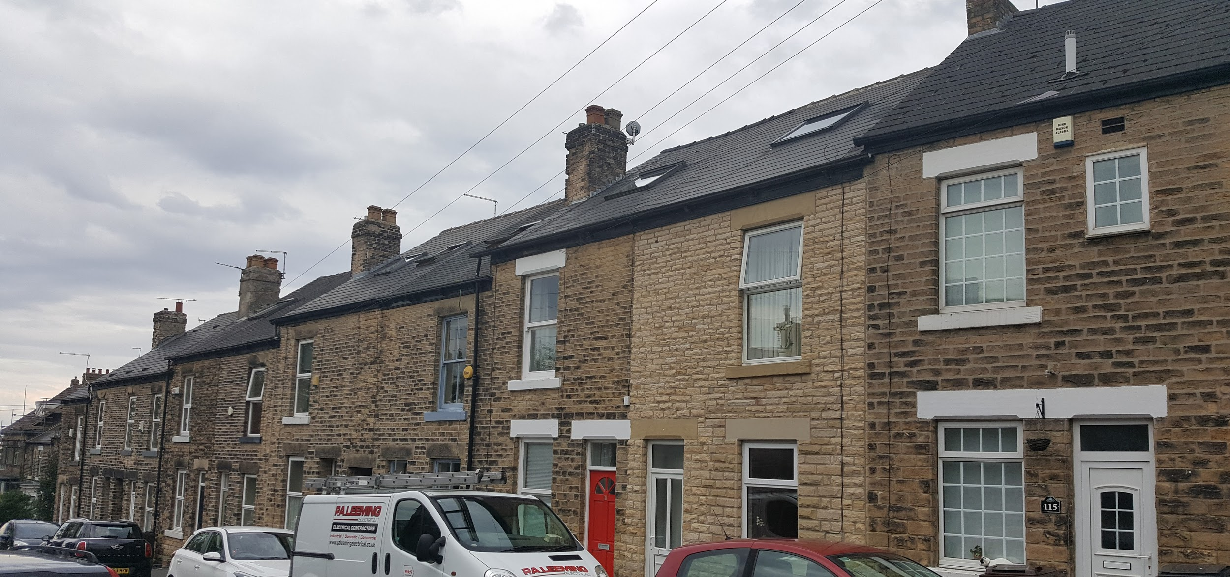
People’s Homes

Slide 4
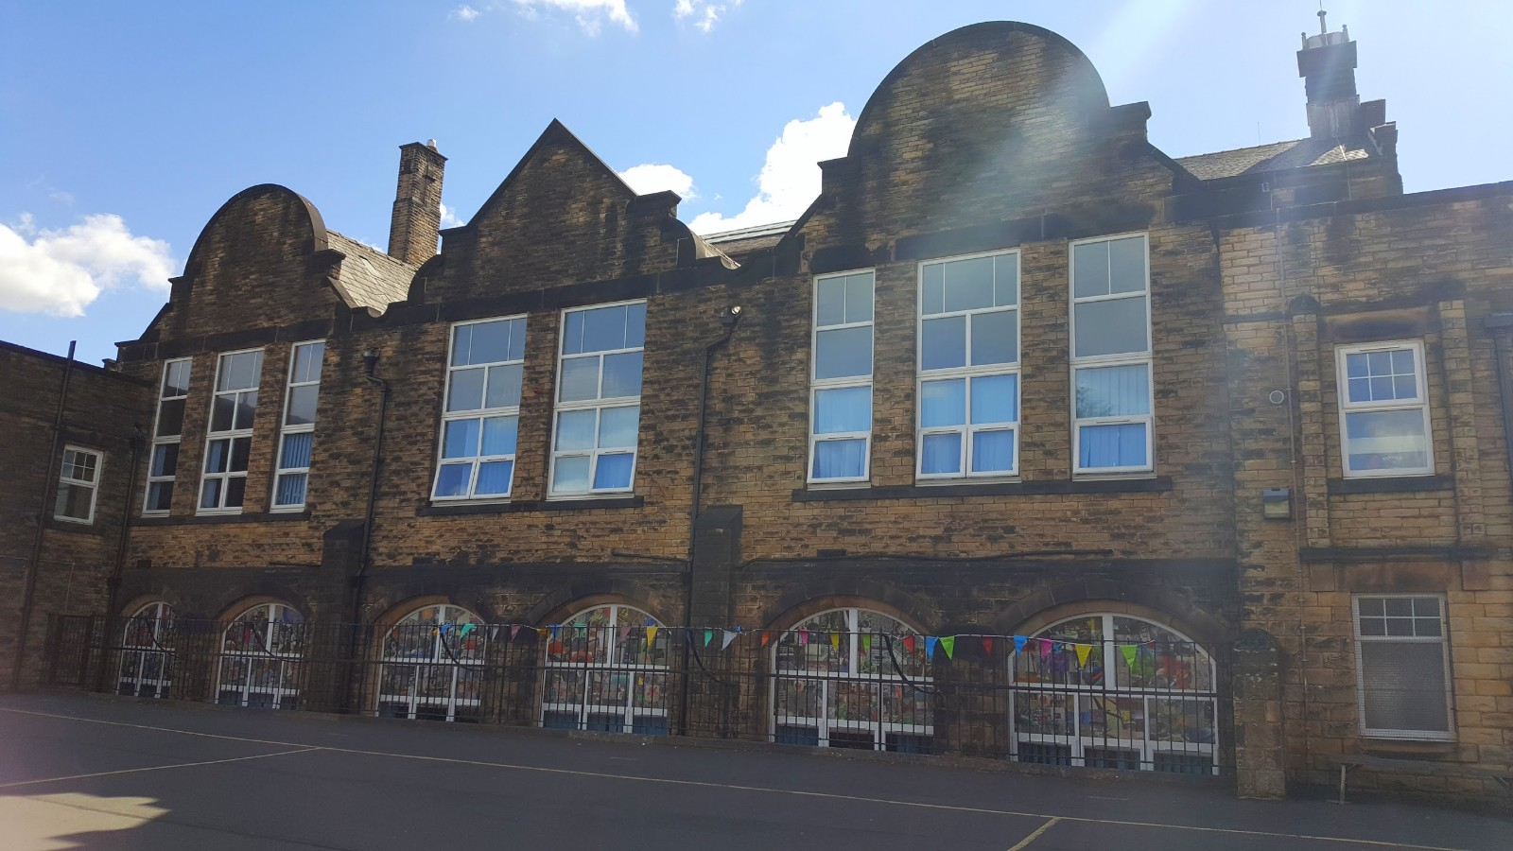
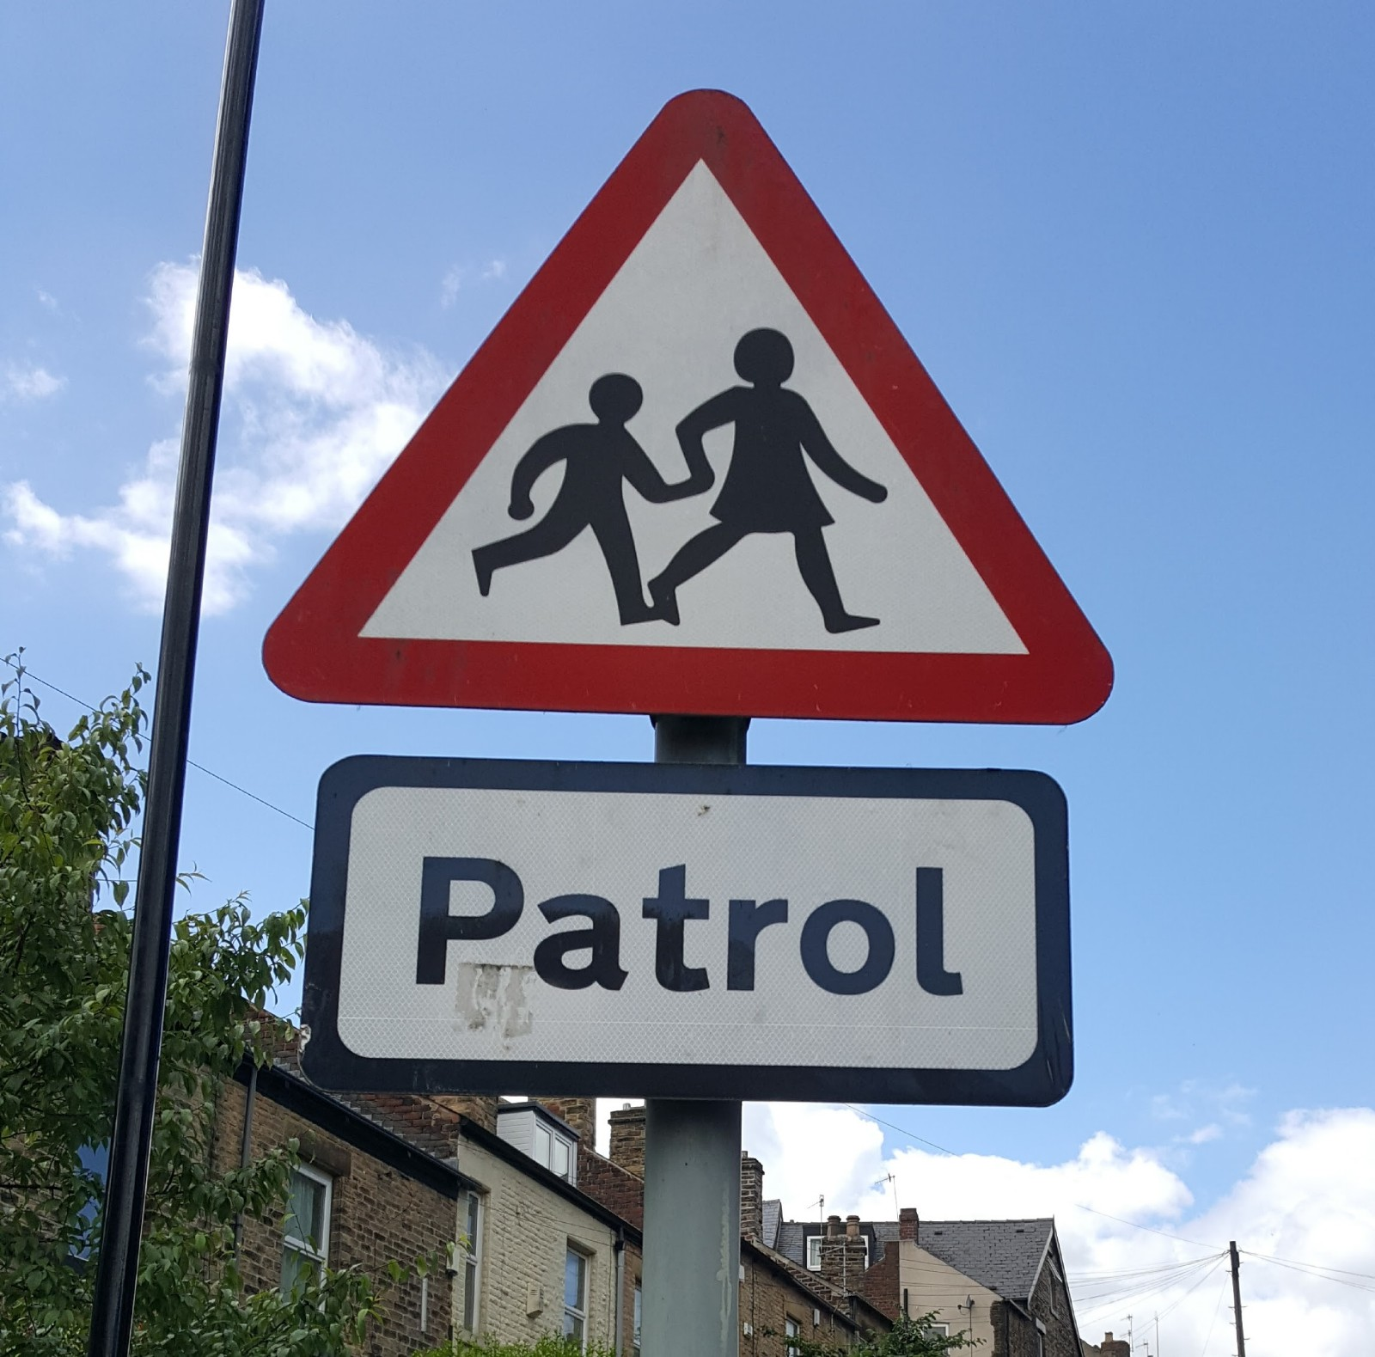
School

Slide 5

Pharmacy

Slide 6
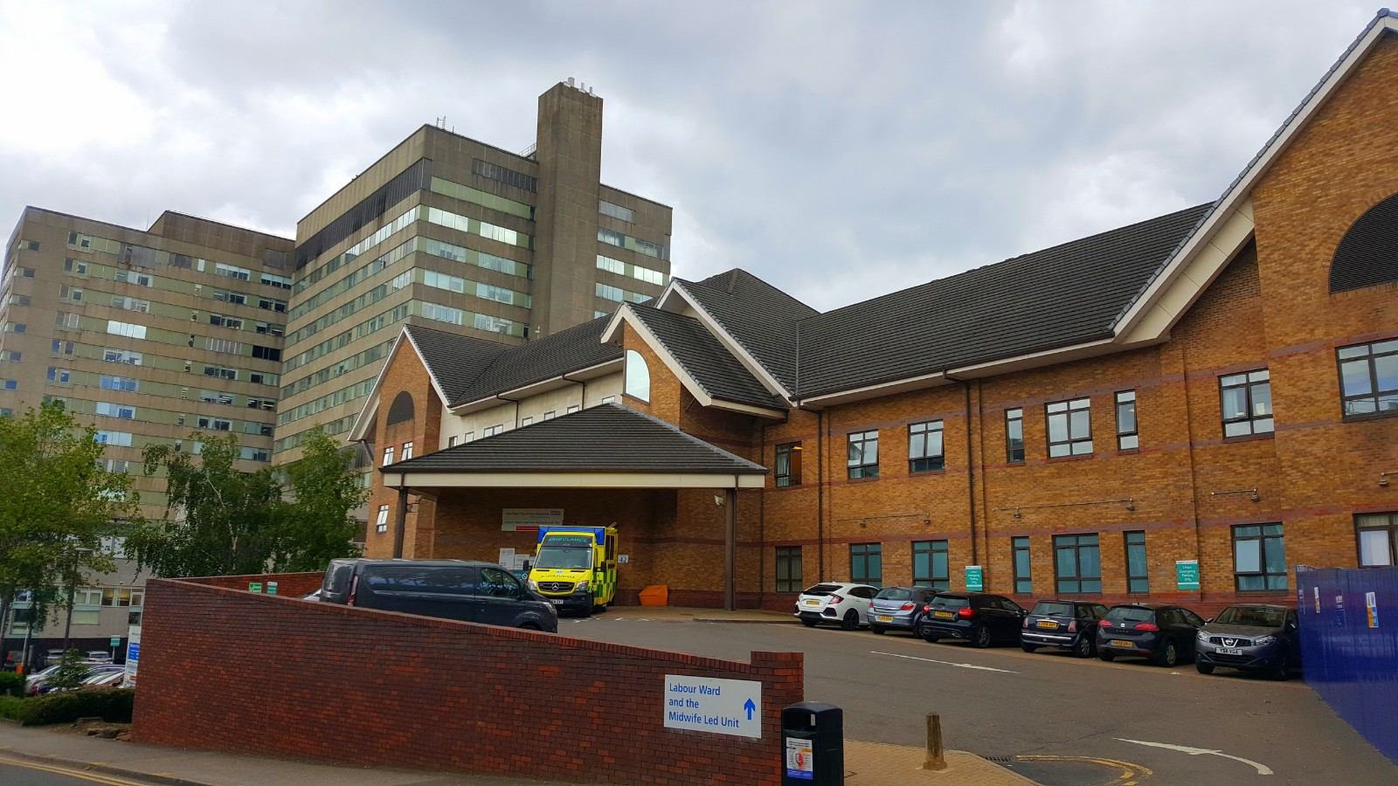
Hospital

Slide 7
Also:
Laboratory
Care Home
Medical Centre
Hospice
Office
Cafe/Canteen
And more...

Slide 8


